Slide 1
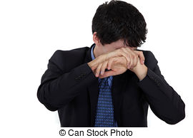
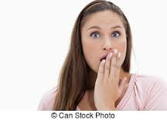
Abash: make someone feel ashamed

Slide 2
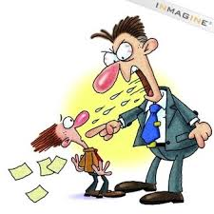
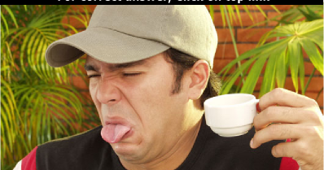
Abhor : to hate/detest/loathe

Slide 3
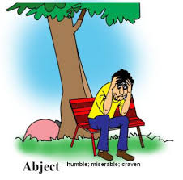
Abject : extremely unpleasant
( abject poverty / an abject apology )

Slide 4
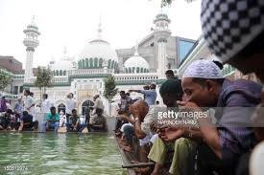
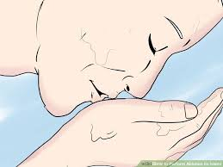
Ablutions: a ceremonial act of washing body

Slide 5

adapt
to change / modify

Slide 6
It is fascinating to see life forms cope with varied environment conditions.
adopt to (b) adapt to
(c) adept to (d)accept with
GATE 2014 EE + CS Set I-III
Answer: b

Slide 7
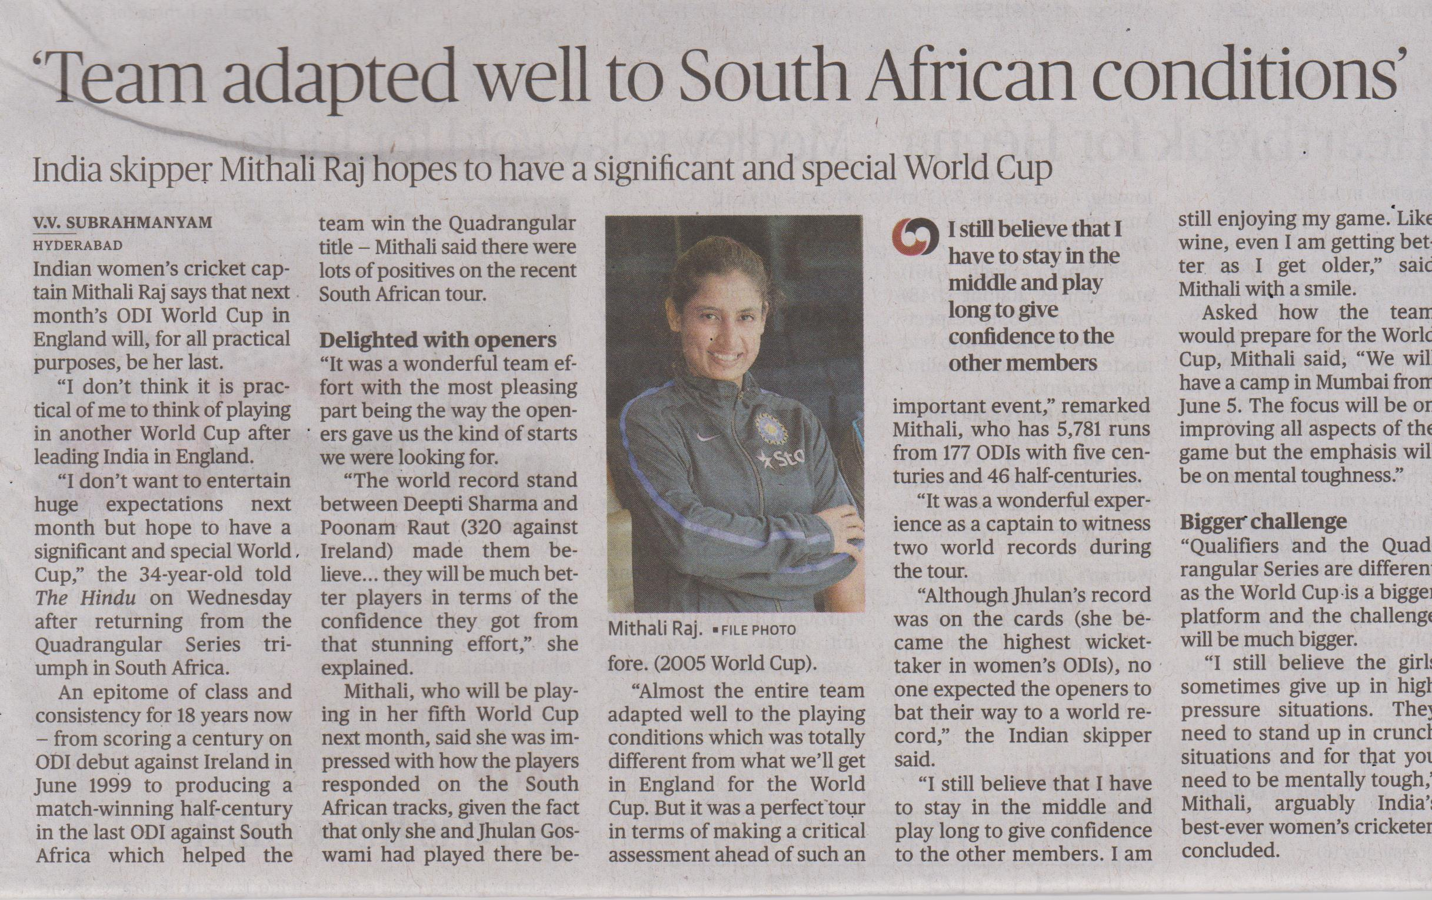

Slide 8

adept
Skillful/adroit/dexterous
www.sahanafoundation.net

Slide 9
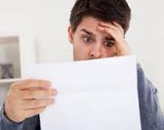
Aghast : to be filled with horror and surprise
Sahana foundation .
In India , according to estimates , 180 children go missing on an average every day .

Slide 10
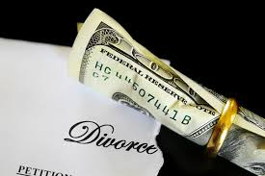
Alimony : money paid to the former spouse after the divorce ( by court order )
www.sahanafoundation.net
Notes:
alimony

Slide 11
Palimony : money that is paid to the partner that one had lived with after the separation

Slide 12

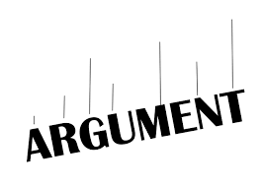
altercation
noisy
The no. of untraced children in the country increased by 84% between 2013 and 2015 .
Sahana foundation .

Slide 13
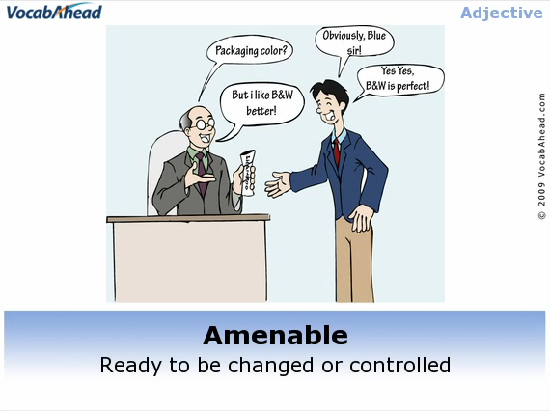
amenable

Slide 14


amenable
Willing to do / compliant / manageable / flexible
Sahana foundation

Slide 15
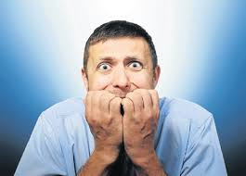
Angst : a feeling of anxiety and worry
The total no. of untraced children in 2015 was 62,988 as against 34,244 in the year 2013. sahana foundation .

Slide 16
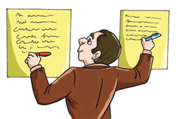
Ambidexterous : able to use both the hands equally well
According to a recent PTI reply from the Delhi police , 22 children go missing in Delhi every day
Sahana foundation
www.sahanafoundation.net

Slide 17
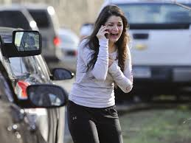
Anguish :
Severe mental or physical pain
3037 CASES OF MISSING CHILDREN HAVE BEEN REGISTERED IN HYDERABAD ZONE IN THE PAST 4 YEARS TIMES OF INDIA

Slide 18
Please do not encourage beggars who exploit children .
Srinivas
Sahana foundation
www.sahanafoundation.net

Slide 19

Anonymous : unnamed /unidentified

Slide 20
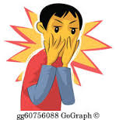
appalling
Shocking / horrific / ghastly / dreadful
According to CRY , Maharashtra and Delhi have the maximum no. Of untraced children
Sahana foundation

Slide 21
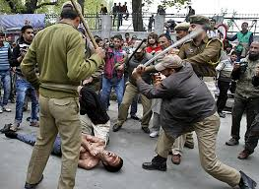
Atrocity: a cruel action

Slide 22
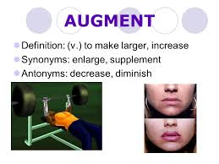
To enlarge / improve /intensify / enhance

Slide 23

august
Distinguished / eminent / renowned / noble
M.P. and Haryana have witnessed around 60% growth in the no. of untraced children in the last three years . Sahana foundation .

Slide 24
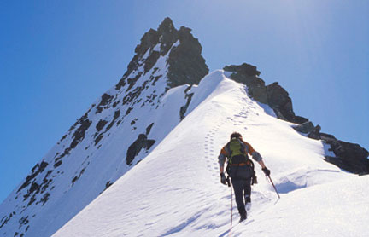
Zenith: THE HIGHEST PONT
sahana

Slide 25

acme
Pinnacle / summit /
Cliff / zenith / apex
www.sahanafoundation.net

Slide 26
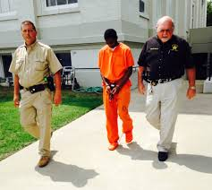
Accused: the person charged with a crime
www.sahanafoundation.net

Slide 27
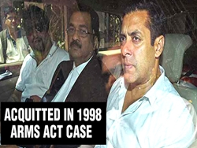
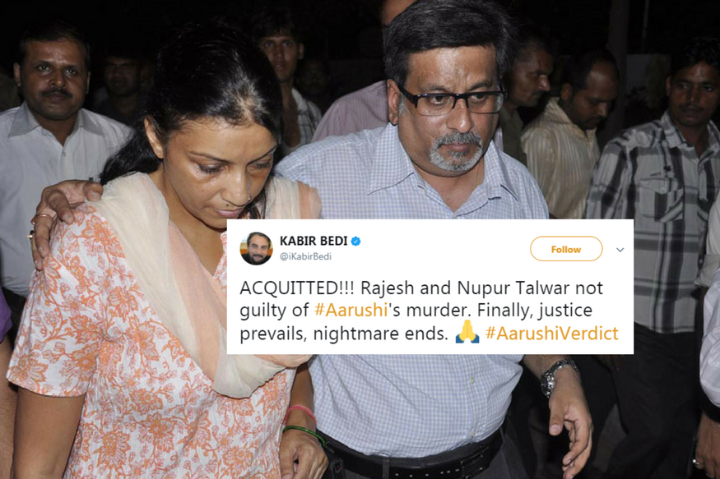
Acquit : to free ( someone ) from a criminal charge

Slide 28
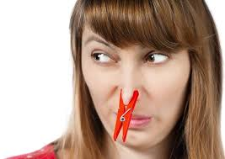
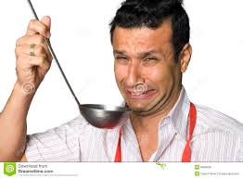
awful
Very bad / unpleasant / disgusting / horrible / loathsome / lousy

Slide 29

averse
Example : most of the beggars are averse to rehabilitation , they prefer to lead wretched lives though there are better ways to live.
www.sahanafoundation.net

Slide 30
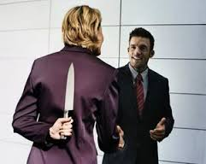
Betray :
Cheat / deceive / be disloyal
www.sahanafoundation.net

Slide 31

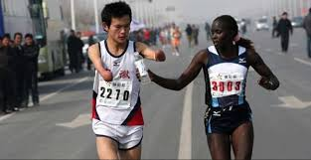
benevolence

Slide 32
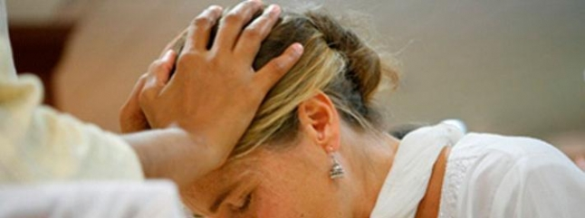
Benediction : blessing
www.sahanafoundation.net

Slide 33

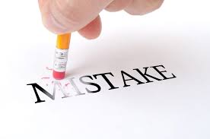
Blunder : mistake / error / debacle

Slide 34
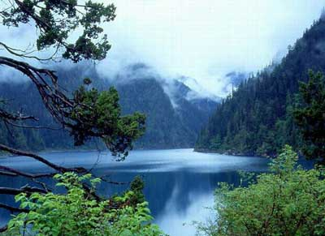
Balmy ( weather ) : pleasant
sahana foundation

Slide 35
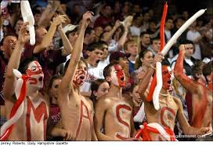
Boisterous : noisy /lively/ full of energy

Slide 36
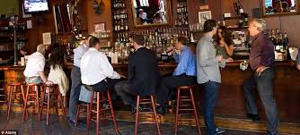
Booze : to drink alcohol

Slide 37

Absolute : complete / utter / entire / perfect / outright .
sahana

Slide 38

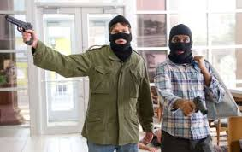
accomplice
Sahana foundation

Slide 39
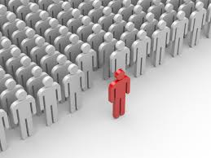
Aberrant : unusual
Please do not encourage beggars who exploit children . Sahana foundation

Slide 40
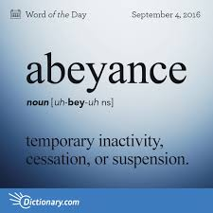
abeyance

Slide 41
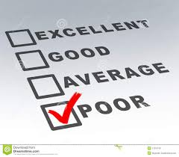
abysmal
Hopeless / woeful / shameless / very low / disgraceful

Slide 42
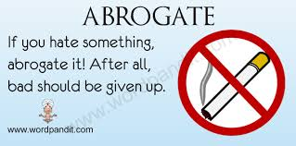
Abrogate : to put an end

Slide 43
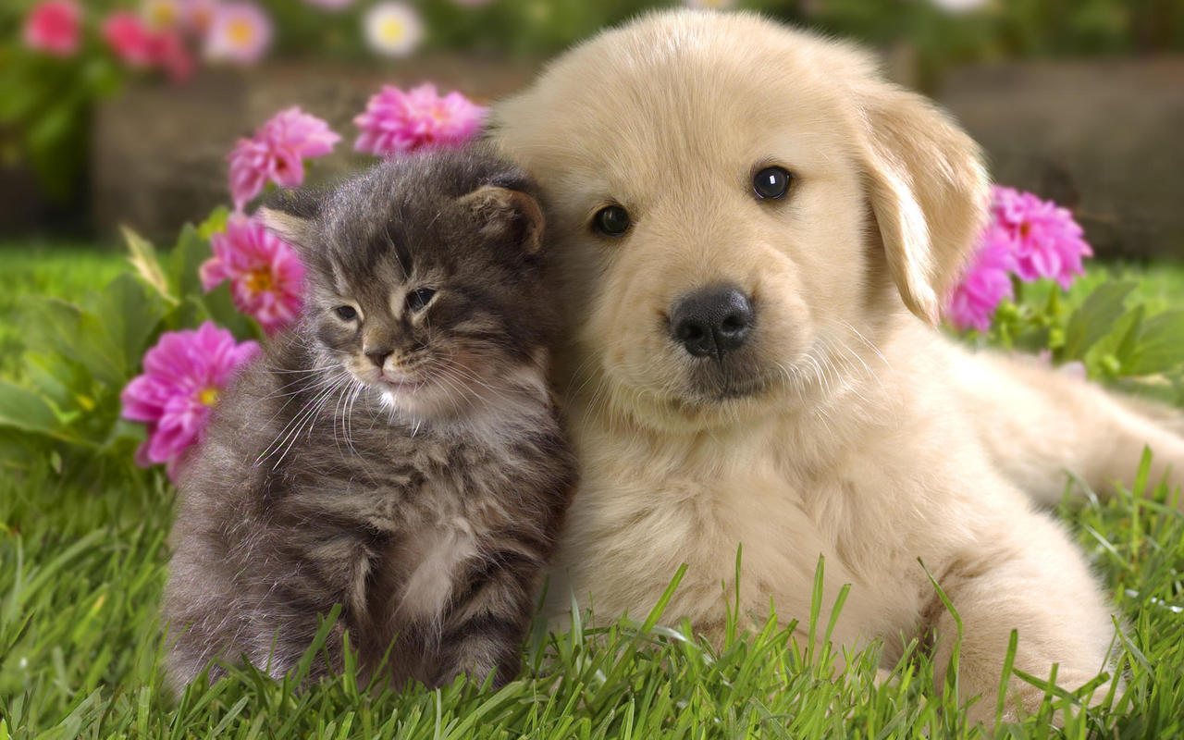
affable
We are friends
Sahana foundation

Slide 44

amnesia
Sahana foundation

Slide 45
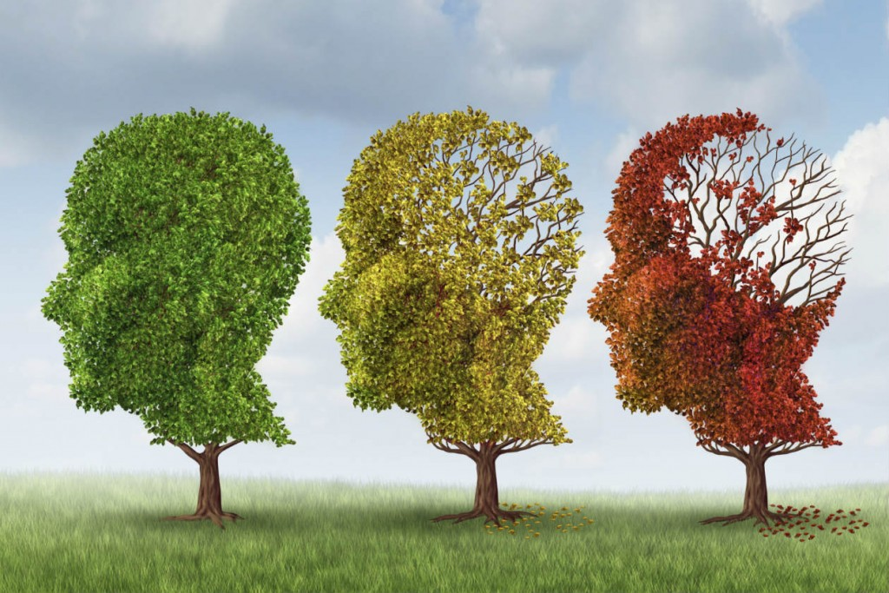
amnesia
Loss of memory

Slide 46
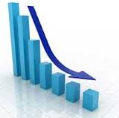
attrition
Weakening / wearing down / enfeebling
Sahana foundation

Slide 47

Baffled : confused/ perplexed/ bemused/bewildered/puzzled/bamboozled
Sahana foundation

Slide 48
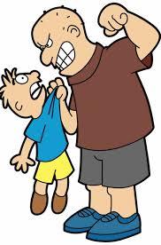
bully
To frighten / intimidate /oppress / coerce
beggar
child
www.sahanafoundation.net

Slide 49
When you see kids begging , give them food instead of money , please do not allow them to get used to making money .
Srinivas
Sahana foundation .

Slide 50
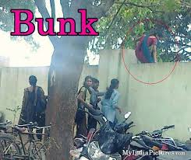
Bunk
Skip / avoid / shirk
Sahana foundation

Slide 51
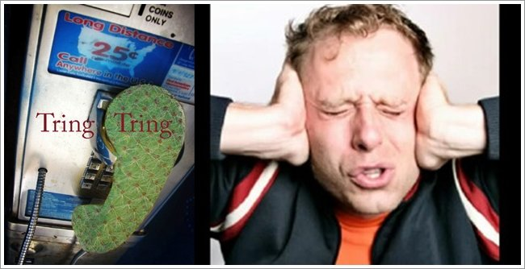
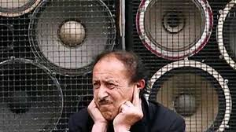


Slide 52
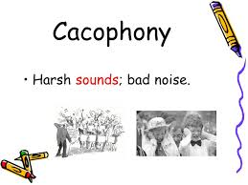
cacophony

Slide 53
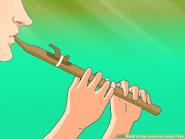
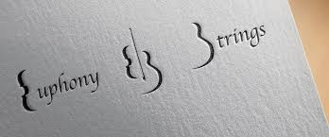
Euphony : a pleasant sound

Slide 54
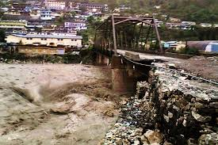
calamity
Disaster / catastrophe / great damage

Slide 55
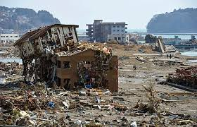
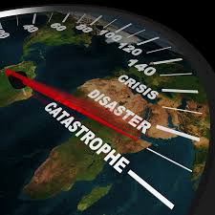
catastrophe
www.sahanafoundation.net

Slide 56

Calligraphy : The art of decorative hand writing .

Slide 57
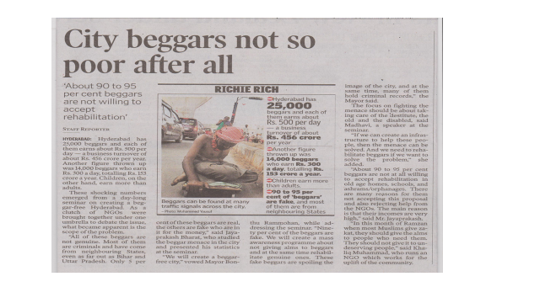
Source : The Hindu
www.sahanafoundation.net

Slide 58

capitulate
Surrender / yield / succumb / cease to resist
M.P. and Haryana have witnessed around 60% growth in the no. of untraced children in the last three years .

Slide 59

Casanova: a man who is passionate about women and has many lovers
www.sahanafoundation.net

Slide 60

chide
To scold / rebuke / upbraid / castigate / reprimand / admonish

Slide 61

Clandestine : hidden / secret/covert
www.sahanafoundation.net

Slide 62

clasp
Grasp ( something ) tightly with one’s hand / grip / clutch

Slide 63

collision
Crash / smash / clash / bump / knock
www.sahanafoundation.net

Slide 64

Combat :
To fight / attack / obstruct / confront
www.sahanafoundation.net

Slide 65

commend
To praise / laud / hail / applaud / clap / extol

Slide 66

conceal
To hide / tuck away / shroud

Slide 67


Sahana foundation
Commend : to praise

Slide 68

confrontation
A dispute / fight / battle .
Sahana foundation

Slide 69


Agreement / assent /accord / concurrence
www.sahanafoundation.net

Slide 70

Conspiracy : a secret plan/plot/scheme/ stratagem
Sahana foundation

Slide 71

Sahana foundation

Slide 72

cantankerous
Irritable/ irascible / bad tempered
www.sahanafoundation.net

Slide 73

Contemplate : to think / consider / ponder

Slide 74

Convalesce:
Recover / recuperate / regain one’s health after illness
www.sahanafoundation.net

Slide 75


Convict : declare ( someone ) to be guilty of a crime

Slide 76

Convivial : friendly / genial / affable / amiable
www.sahanafoundation.net

Slide 77

Corpse: dead body /deceased body
www.sahanafoundation.net

Slide 78

corpulent
Obese / fat
www.sahanafoundation.net

Slide 79

corroborate
Corroborate : confirm / validate / ratify / to add proof
www.sahanafoundation.net

Slide 80

Crooked: bent / twisted / out of shape

Slide 81

CROOKED ( adjective ) : dishonest / illegal
Crook ( noun ) : a criminal
www.sahanafoundation.net

Slide 82

Culmination : the end of an activity /event/ process
Please do not encourage beggars who exploit children . Sahana foundation.

Slide 83

culprit
Offender / wrong doer / person responsible for a crime or misdeed

Slide 84
Root: culp
Meaning : blame
Culpable : blamable
Culprit: one who deserves the blame
Inculpate : to blame / incriminate / accuse
Exculpate : to declare that someone is not guilty
www.sahanafoundation.net

Slide 85

Dally
Dawdle / delay / linger / lag
www.sahanafoundation.net

Slide 86

Dainty: small /delicate
Sahana foundation

Slide 87

Dearth
Lack / scarcity / deficiency / paucity / shortfall / meagerness

Slide 88

declivity
A downward slope

Slide 89

deface
Spoil / mar / ruin / tarnish / deform

Slide 90

deference
Respect / regard / courtesy / politeness

Slide 91

defiant
Resistant / uncooperative / recalcitrant / obstinate / disobedient

Slide 92

deluge
Flood / down pour

Slide 93

Denounce: to criticize publicly

Slide 94
Deplorable : disgraceful/shameful /unworthy

Slide 95

Deter : prevent / stop/ discourage

Slide 96

Detrimental : harmful / injurious

Slide 97

Dilapidated : worn out / about to collapse / ramshackle
i

Slide 98

Diffuse : to spread / disperse

Slide 99

discord

Slide 100




DISSENT : TO DISAGREE / PROTEST / DIFFER

Slide 101
GATE 2014 ME + EC
Which of the following is the closest in meaning to the word underlined in the sentence below ?
In a democracy , everybody has the freedom to disagree with the government
( a ) dissent
( b ) descent
( c ) decent
( d ) decadent
Answer : ( a )

Slide 102


Diligent
Hardworking / industrious / assiduous

Slide 103



Slide 104

Docile: flexible / obedient / ready to accept / meek

Slide 105

Dolorous: sad / gloomy/sorrowful

Slide 106

Drowsy : sleepy / dozy / somnolent

Slide 107

Ebullient: cheerful / euphoric / effervescent

Slide 108

Edict: order / dictate / command

Slide 109

Eerie : strange and frightening/ creepy/ mysterious

Slide 110

Efface: erase / remove

Slide 111

Effeminate : womanish/unmanly

Slide 112

Effigy : dummy/ statue

Slide 113

Egalitarian: believing the principle of equality

Slide 114

Egress : go out / leave

Slide 115

Elated : euphoric / ecstatic / overjoyed

Slide 116

Elicit : obtain / extract

Slide 117

Elope: go away with lover

Slide 118

Elucidate: explain clearly

Slide 119

Elusive: difficult to find / catch

Slide 120

Emaciated : abnormally thin

Slide 121


Emancipate : to liberate / free

Slide 122

Embark: to get into a plane or go on a ship

Slide 123

Disembark : to get off a ship / a plane

Slide 124

Embellish : to decorate

Slide 125

Enmity : hatred

Slide 126




Slide 127

Enthrall : woo / charm/captivate

Slide 128

Eradicate : root out/remove

Slide 129

Errand: chore / task/job

Slide 130

Estrange :To distance/alienate

Slide 131

EXASPERATE : INCENSE /ANGER / MADDEN/ANNOY

Slide 132

Excruciating: intensely painful

Slide 133

Extravaganza: spectacular display

Slide 134


Falter: hesitate /delay

Slide 135


Fatuous: silly / foolish /inane

Slide 136

FAUX PAS : AN EMBARRASSING BLUNDER

Slide 137

Feeble : weak / frail/infirm

Slide 138


Felicity : joy / bliss

Slide 139


Felicitate : to honour in a public place

Slide 140
GATE 2016 EC + ME
The students ___________ the teacher on teachers’ day for twenty years of dedicated teaching .
( a ) facilitated
( b ) felicitated
( c ) fantasized
( d ) facillitated
Answer : ( b )

Slide 141

Felony : a crime

Slide 142


Feral: wild/undomesticated/untamed

Slide 143

Flabbergast :astonish/amaze/surprise

Slide 144

Folly: senseless/foolish

Slide 145

Fragile : delicate / breakable

Slide 146

Fraught: anxious/worried/upset

Slide 147

Frown :an expression of irritation

Slide 148

Gag : to prevent someone from speaking

Slide 149

Gallantry : courage/bravery/valour

Slide 150

Garish : glaring / over-bright /flashy

Slide 151

Garner : gather / collect / assemble

Slide 152

Gawk : stare / gape / gaze /

Slide 153

Gigantic: huge / large / enormous

Slide 154

Glum: gloomy / depressed / dull

Slide 155

Glutton: greedy eater

Slide 156




Slide 157

Gourmet : epicure /quality conscious of food

Slide 158

gorgeous
Very beautiful

Slide 159

Gossip :informal conversation about other people’s private affairs

Slide 160

Grandeur: splendour /magnificence

Slide 161

Grapple : wrestle / engage in a close fight

Slide 162



GRASP : seize and hold firmly / clasp / clutch / grab / snatch

Slide 163
GATE : 2016 IN + EC
The Buddha said , “ holding on to anger is like grasping a hot coal with the intent of throwing it at someone else : you are the one who gets burnt “
SELECT THE WORD WHICH IS CLOSEST IN MEANING TO THE WORD UNDERLINED
( a ) burning
( b ) igniting
( d ) flinging
( c ) clutching
Answer : ( c )

Slide 164

Grievous : severe / bad / grave / terrible

Slide 165




guffaw

Slide 166

Guffaw : laugh out loudly ( LOL)

Slide 167

Haggard : looking exhausted and unwell

Slide 168

Hapless : unlucky /unfortunate

Slide 169

Hasten: move hurriedly /rush

Slide 170

Expedite : hasten

Slide 171


Slide 172

Haughty : proud /vain / conceited

Slide 173

Please do not encourage beggars who exploit children
Sahana foundation

Slide 174


hazardous
dangerous

Slide 175

Stubborn : obstinate / inflexible / unyielding
stubborn

Slide 176

Head strong : stubborn / unyielding

Slide 177

Heinous : wicked / evil / atrocious

Slide 178

Horde : crowd / a large group .

Slide 179

Horrendous : extremely unpleasant / horrifying

Slide 180

Hurdle: obstacle /barrier / problem/obstruction

Slide 181


Lazy / sluggish / slothful / indolent
lethargic

Slide 182

Idle : lazy

Slide 183

Illegible: unreadable

Slide 184

illegible

Slide 185

Please do not encourage beggars who exploit children .
Sahana foundation .

Slide 186

Illicit : illegal / forbidden /unlawful

Slide 187

imbecility

Slide 188

Imbibe: to drink
Ex :
If you imbibe ideas , you accept them .

Slide 189

Imminent: close / near / forthcoming/about to happen

Slide 190

Immolate: killing the self by burning

Slide 191

Immune: resistant/ not vulnerable

Slide 192

Immure: confine /imprison /incarcerate/jail

Slide 193

www.sahanafoundation.net

Slide 194

Immutable : unchangeable / fixed /unshakeable
www.sahanafoundation.net

Slide 195

Impasse: a difficult situation in which it is impossible to make progress/ halt / stand-off / stop
sahana

Slide 196

Implicate: to show that someone is involved in a crime/inculpate/incriminate

Slide 197

Impound : seize and take legal custody

Slide 198

Impromptu unprepared/unrehearsed/extempore

Slide 199

Incessant: continuous / nonstop

Slide 200


Slide 201

Incongruous: strange / different /unfitting

Slide 202

Inconspicuous :unclear /not seen easily

Slide 203

Indelible: long lasting /unlikely to be forgotten
Please do not encourage beggars who exploit children
Sahana foundation

Slide 204

Infuriate : enrage / incense / anger / madden
Ex : we get infuriated by the stupid behaviour of people .

Slide 205

Insane: mad / Mentally ill

Slide 206

Instigate: to provoke / make someone do something

Slide 207

Interlocutor: representative / a person who talks on behalf of another

Slide 208

Intimidate : to frighten/menace/terrify/scare/daunt

Slide 209

Intrude: to go into a place without permission/trespass

Slide 210



Innocuous :
harmless

Slide 211

Irony: odd or amusing because it involves a contrast

Slide 212

IRREVOCABLE : THAT CANNOT BE CHANGED OR REVERSED
Ex: let us take an irrevocable decision to rescue children from begging mafia

Slide 213

Isolated: alone
Sahana foundation

Slide 214

Jamboree: a celebration where there is a huge crowd

Slide 215

Jeopardy: a dangerous situation
Ex:
The lives of many children , used by beggars are undoubtedly in a jeopardy .

Slide 216

Jubilation: a feeling of great happiness

Slide 217

Lanky: tall and thin

Slide 218


Lustrous : shiny / glossy / radiant / bright

Slide 219



Slide 220

Latent: hidden at the moment , not obvious

Slide 221

Legitimate: acceptable according to the law

Slide 222
Lazy / sluggish / slothful / indolent
lethargic

Slide 223

Lethargic : lazy

Slide 224

liability

Slide 225

Loquacious : talkative

Slide 226

The child being used in begging near hauzkhas metro in Delhi
www.sahanafoundation.net

Slide 227


Magnanimous : generous /charitable / benevolent / altruistic / philanthropic

Slide 228

Majestic : great / awesome .
www.sahanafoundation.net

Slide 229

Malady : ailment / sickness / disorder
www.sahanafoundation.net

Slide 230

Mammoth : huge / large / massive / gigantic / giant /colossal
Children are godly , let them not be ruined by the demons of begging
sahanafoundation

Slide 231

Massacre: mass killing / mass slaughter
www.sahanafoundation.net

Slide 232


Slide 233

Melancholy: sadness / sorrow
www.sahanafoundation.net

Slide 234


Memento
Keepsake /souvenir

Slide 235
GATE : 2015 EE + EC
The principal presented the chief guest with a ________ , as a token of appreciation .
( a ) momento
( b ) memento
( c ) momentum
( d ) moment
Answer : ( B )

Slide 236

Miniscule : minute / very small / tiny
www.sahanafoundation.net

Slide 237

Mirth: cheerfulness /glee/fun
www.sahanafoundation.net

Slide 238

Miscreant : wrong doer / offender / culprit

Slide 239

Mishap : accident /misfortune
Sahana foundation

Slide 240

Mitigate : lessen / reduce / alleviate
www.sahanafoundation.net

Slide 241
GATE : 2012 CS , MECHANICAL & CIVIL
Which one of the following options is the closest in meaning to the word given below ?
MITIGATE
( a ) diminish
( b ) divulge
( c ) dedicate
( d ) denote
Answer : ( a )

Slide 242

Monstrous: ugly / gruesome /horrible / hideous

Slide 243

Moron : utterly stupid

Slide 244

Muster: gather /assemble/ collect

Slide 245

Mutilate: cut to pieces / butcher /tear apart/damage / mar
www.sahanafoundation.net

Slide 246

nadir
Lowest point

Slide 247

Nadir : The lowest point

Slide 248

Neologism: a newly coined word

Slide 249

Neophyte :novice / tyro / beginner / learner

Slide 250

Nightmare : a frightening dream / a very unpleasant experience
Ex: losing children is an everlasting nightmare for the parents
www.sahanafoundation.net

Slide 251

Nocturnal : active at night

Slide 252

Nonchalant : feeling casually calm and relaxed / not displaying anxiety or enthusiasm
Sahana foundation

Slide 253

Noxious : harmful / poisonous

Slide 254

Obnoxious : unbearable / extremely unpleasant

Slide 255

Obsolete: outdated / old-fashioned

Slide 256

Obstinate: stubborn / disobedient

Slide 257

obscure
unclear
hazy

Slide 258

Occlude : stop / obstruct / block off

Slide 259


Ombudsman : an official who hears and investigates complaints by private citizens against government agencies

Slide 260

Orator : a public speaker

Slide 261

Palatial : spacious and splendid

Slide 262


Paltry : small / meagre /negligible

Slide 263

Panacea : a remedy for all difficulties or diseases / cure for all

Slide 264

Pandemonium : wild and noisy disorder or confusion ; uproar

Slide 265


panache

Slide 266

Panic : sudden uncontrollable fear

Slide 267

Panorama : a large view / a bird ‘s eye view

Slide 268

Paramount : supreme / uppermost / predominant

Slide 269

Pariah : a person who is rejected by the society

Slide 270

Parley : meeting / conference / summit

Slide 271

Patronage : support / backing

Slide 272

Persevere : persist / continue to do even in difficulties

Slide 273

Persist : endure / to do in a determined way

Slide 274

Perspire : to sweat

Slide 275

Pious : spiritual / holy / godly / saintly

Slide 276

Pivotal : crucial / vital / critical

Slide 277

Plight : a difficult , unfortunate situation

Slide 278

Polygamy : the custom of having more than one wife or husband

Slide 279
Monogamy : the practice of marrying one person
Bigamy : the practice of marrying two persons
Polyandry : the practice of having more than one husband

Slide 280

Pomp : splendid display

Slide 281

Populace : population/inhabitants/ residents of an area or a country

Slide 282

Posthumously : happening after a person’s death
Ex :
The author’s last book was published posthumously .

Slide 283

Predicament : a difficult situation

Slide 284

PREY : AN ANIMAL THAT IS HUNTED AND KILLED FOR FOOD

Slide 285


Profuse : produced in large amounts

Slide 286


Ban / prohibit / bar / forbid / disallow
Ex : child trafficking should be proscribed as soon as possible .

Slide 287

Placid : calm / peaceful / serene

Slide 288


Perennial : ever lasting
Ex : poverty seems to be a perennial problem in India

Slide 289


Profound : extreme / deep / strong
Ex : (1) his profound knowledge on the subject surprised all of us
(2)
The sudden death of his father had a profound effect on his life

Slide 290

Proliferate : to increase a lot
Ex : The number of entertainment channels has proliferated in the last few years .

Slide 291



Promising : good / encouraging / hopeful / favourable

Slide 292

Prudence : wisdom / judgement / sagacity / common sense / shrewdness

Slide 293

Pugnacious : quarrelsome / fond of fighting / combative

Slide 294

Punitive : harsh / severe / stringent

Slide 295

Quench : satiate / satisfy one’s thirst by drinking water

Slide 296

Query: question / enquiry

Slide 297

Quietude: calmness /stillness/ quiet

Slide 298

Quiescent : in a state of inactivity/ fallow/passive/inoperative

Slide 299

Rapport : a close relationship in which the people understand each other and communicate well
Bond / harmony /understanding

Slide 300

To confirm / consent / approve

Slide 301

Ravenous : extremely hungry

Slide 302

Rebellious : disobedient / unruly/ insubordinate

Slide 303

Rebuff : reject / refuse / decline / spurn

Slide 304

Rebuke : scold / reproach / admonish /chide / reprimand

Slide 305

Recalcitrant: disobedient

Slide 306

Reckless : careless/incautious

Slide 307

Redundant : needless /inessential /useless

Slide 308

Refute: To prove that someone is wrong/deny / contradict

Slide 309

Reluctant
unwilling

Slide 310

Remorse: repentance / guilt / deep regret for a wrong committed .

Slide 311

Repercussions : unintended results/ consequences

Slide 312

replica: the accurate copy of something

Slide 313

Reprehensible ( behaviour / idea ): very bad/wrong

Slide 314

Resentment: anger

Slide 315

Respite: a short period of rest from something unpleasant

Slide 316

Retrieve: to get something back from where we left it

Slide 317


Slide 318

Resurrect: to cause something to exist again after it had ended

Slide 319

Reverence : great respect

Slide 320
Gossip :informal conversation about other people’s private affairs

Slide 321

Ruthless: harsh / merciless

Slide 322

Sanguine: cheerful and confident

Slide 323

Scant: very little

Slide 324

Shambles: disorder

Slide 325

Shrewd: wise

Slide 326


Sibling : brother or sister

Slide 327

Skeptical: doubtful

Slide 328

Slay: to kill

Slide 329

Solidarity: supporting one another

Slide 330

Soliloquy: the act of speaking to the self

Slide 331


The person who walks in sleep

Slide 332



Slide 333

Spouse : life partner ( wife or husband )
Ex : a spouse is not a destination but a fellow traveller .

Slide 334


Spurious : false / not genuine / fake

Slide 335

Stack : a pile

Slide 336

Stagger : to move unsteadily ( when drunk or ill )

Slide 337

Stalk : to follow secretly ( in order to attack )

Slide 338


Slide 339

Strangle: to squeeze the throat tightly

Slide 340

Stringent ( rules / laws ): strict / strict

Slide 341
Stubborn : obstinate / inflexible / unyielding
stubborn

Slide 342

Subdue : to defeat / bring under control

Slide 343

Substantiate: to strengthen a statement or argument with evidence

Slide 344

Succor : to help

Slide 345



Sulky: moody /petulant

Slide 346

Sumptuous : grand and expensive
Sumptuous ambience / clothes / food etc

Slide 347

Symposium: conference

Slide 348

Synchronize: to link properly

Slide 349


TACITURN : HABITUALLY SILENT / RESERVED / RETICENT
www.sahanafoundation.net

Slide 350


Slide 351



Timid
Shy / nervous / lacking courage

Slide 352

Teetotaller : a person who never drinks alcohol

Slide 353

tawdry ( clothes or decorations )cheap/awkward

Slide 354

Temperate( climate or place ) : mild
Temperate ( person’s behaviour ) : calm and reasonable

Slide 355

Tempestuous: very intense /strong

Slide 356

Tenement : large old building which is divided into a no. of flats

Slide 357

Toxic: poisonous

Slide 358

Unanimous : agreeing without a difference of opinion

Slide 359

Uncanny : strange and difficult to explain

Slide 360

Underprivileged: people with less money and fewer opportunities than others

Slide 361

Vandalize : to damage

Slide 362

vengeance

Slide 363

Verbose: full of words( more than necessary )

Slide 364

Veteran : highly experienced / seasoned

Slide 365

Vicious: cruel / bad / violent

Slide 366


vigorous

Slide 367


VINDICATE : clear of a blame / justify / substantiate / confirm

Slide 368
GATE 2014 ME + EC
While receiving the award , the scientist said , “ I feel vindicated “ . Which of the following is closest in meaning to the word vindicated
( A ) punished
( b ) substantiated
( d ) chastened
( c ) appreciated
Answer : ( b )

Slide 369

Vivid : lucid / clear / bright / vibrant

Slide 370

Vow: a serious promise or a decision

Slide 371

Vulnerable: weak / without protection / easily affected
Example : let the vulnerable children not be the scape goats in the hands of beggars

Slide 372

Vie: to compete

Slide 373


Wanderlust: a strong desire to travel

Slide 374

Woes : problems

Slide 375

Yearn: to desire very much

Slide 376




Yell : to shout loudly

Slide 377

Weird : strange / unusual / outlandish / queer / odd / bizarre

Slide 378

A person who is attracted to foreigners
Love / craze for foreigners

Slide 379


Fear of foreigners and strangers

Slide 380

www.sahanafoundation.net

Slide 381

www.sahanafoundation.net

Slide 382

Fear of being in closed places
www.sahanafoundation.net

Slide 383


Slide 384


Choreomania : craze / passion for dance

Slide 385

Dipsomania : abnormal craving for alcohol
Sahana foundation

Slide 386

Delusion about one’s own power or importance

Slide 387

Kleptomania: compulsion to steal things

Slide 388

Bibliomania : craze for books or reading
www.sahanafoundation.net

Slide 389

Clinomania : excessive desire to stay in bed
www.sahanafoundation.net

Slide 390

Pyromania : an obsessive desire to set fire
www.sahanafoundation.net

