Slide 1
Please do not encourage beggars who exploit children .
Srinivas
Sahana foundation
www.sahanafoundation .net

Slide 2
06 /12 / ’17
Dear friends ,
This presentation is aimed at helping my students in MADE EASY only .
I am forced to upload it now , because of pressure from many students but I am going to upgrade it in 10 days with some more useful information and questions.
Srinivas
Faculty – Made easy
9 9 8 5 1 4 3 8 1 7

Slide 3
PARTS OF SPEECH
1 . NOUN : NAME
2 . pronoun : used instead of a noun .
3 . Adjective : Describes quality.

Slide 4
Verb : Action / state
Adverb : Modifies a verb/ an adjective/ adverb
Conjunction : That joins

Slide 5
preposition: : shows the relationship
Interjection : shows a sudden feeling

Slide 6
Noun
The name of a person / place / thing/ action / state / emotion..

Slide 7
Proper noun : the name of a specific person / place / thing .
Common noun : The name that represents the whole class. Ex : boy / girl / city / institution.

Slide 8
Collective noun : The name that denotes a collection of persons / things together as a whole .
Ex : audience / committee / crowd / mob / group .
Proper / common / collective nouns are countable

Slide 9
Abstract noun : name of a Quality / concept / idea / state . Ex : Death, Honesty, Youth, Beauty.
Material noun : The substance with which something is made or prepared . Ex : Gold , Wheat, Iron , Wood.
Abstract and material nouns are uncountable

Slide 10
Countable nouns : the nouns that can be counted .
Ex : boys / girls / books / pens etc .
Uncountable nouns : the nouns that cannot be counted .
Ex : sugar / rice / water / coffee / love / patience etc .
“ A /An “ stand for one ( singular )
“ S “ stands for two or more than two ( plural )
When it is an uncountable noun , we can use neither A nor S with it .

Slide 11
My friend has given advices that helped me in my tough times .
Ans : advice in place of advices
.
Advice is an uncountable noun , we can make it neither singular nor plural
an advice
advices
a piece of advice
Some pieces of advice

Slide 12
People : more than one person
Peoples : people of different nations
EX :
The peoples of India and pakistan

Slide 13
WATER : UNCOUNTABLE NOUN - SINGULAR
WATERS : SPECIFIC BODY OF WATER – IN A LAKE / RIVER / SEA

Slide 14
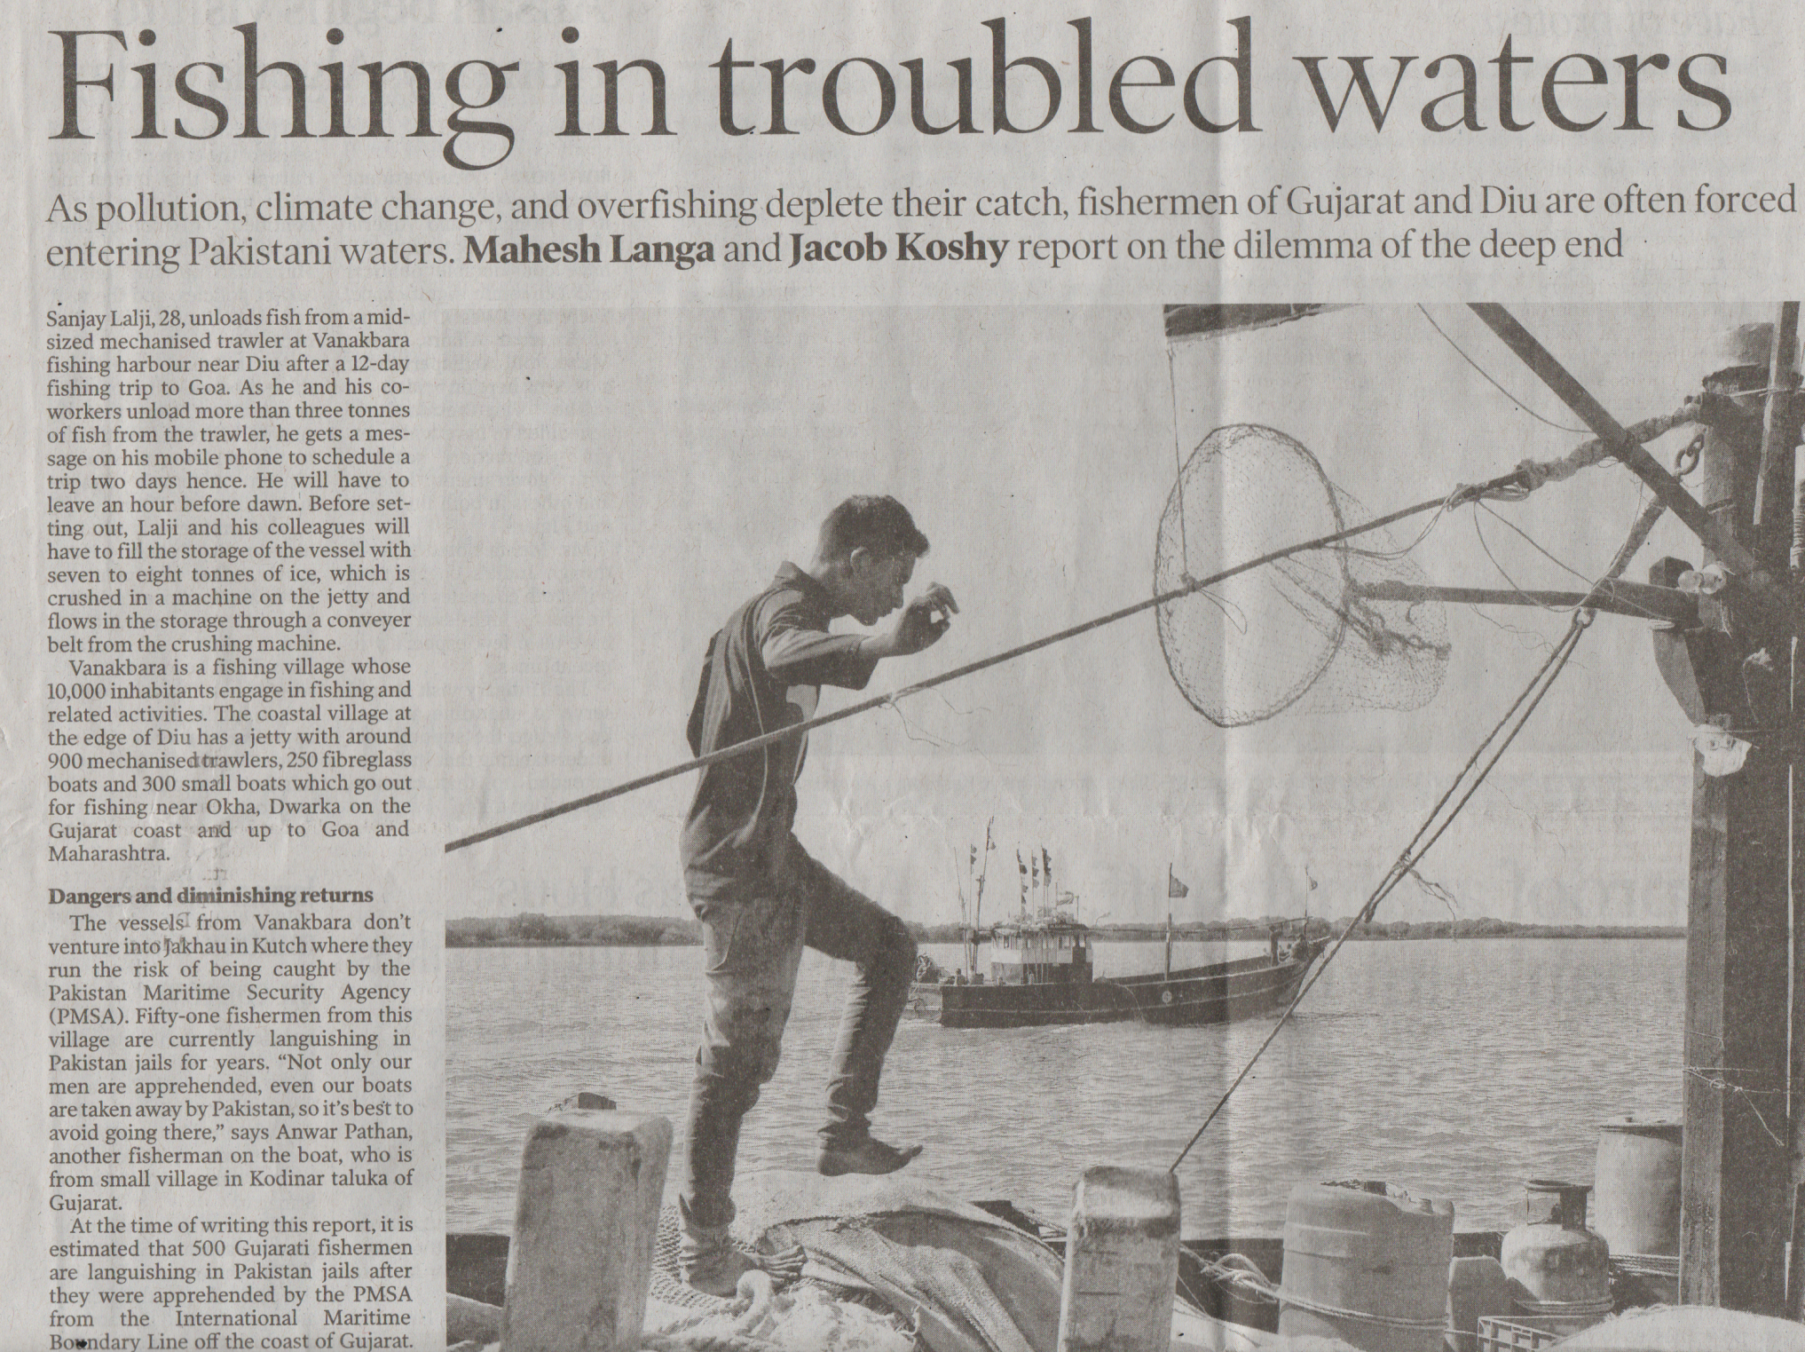

Slide 15
News, information, furniture, luggage, baggage, scenery, poetry , machinery, equipment, alphabet , stationery etc .
are always singular

Slide 16
Scissors, tongs, spectacles, cattle, gentry, poultry, clergy, pants, pantaloons , jeans , tights , shorts
are always plural

Slide 17
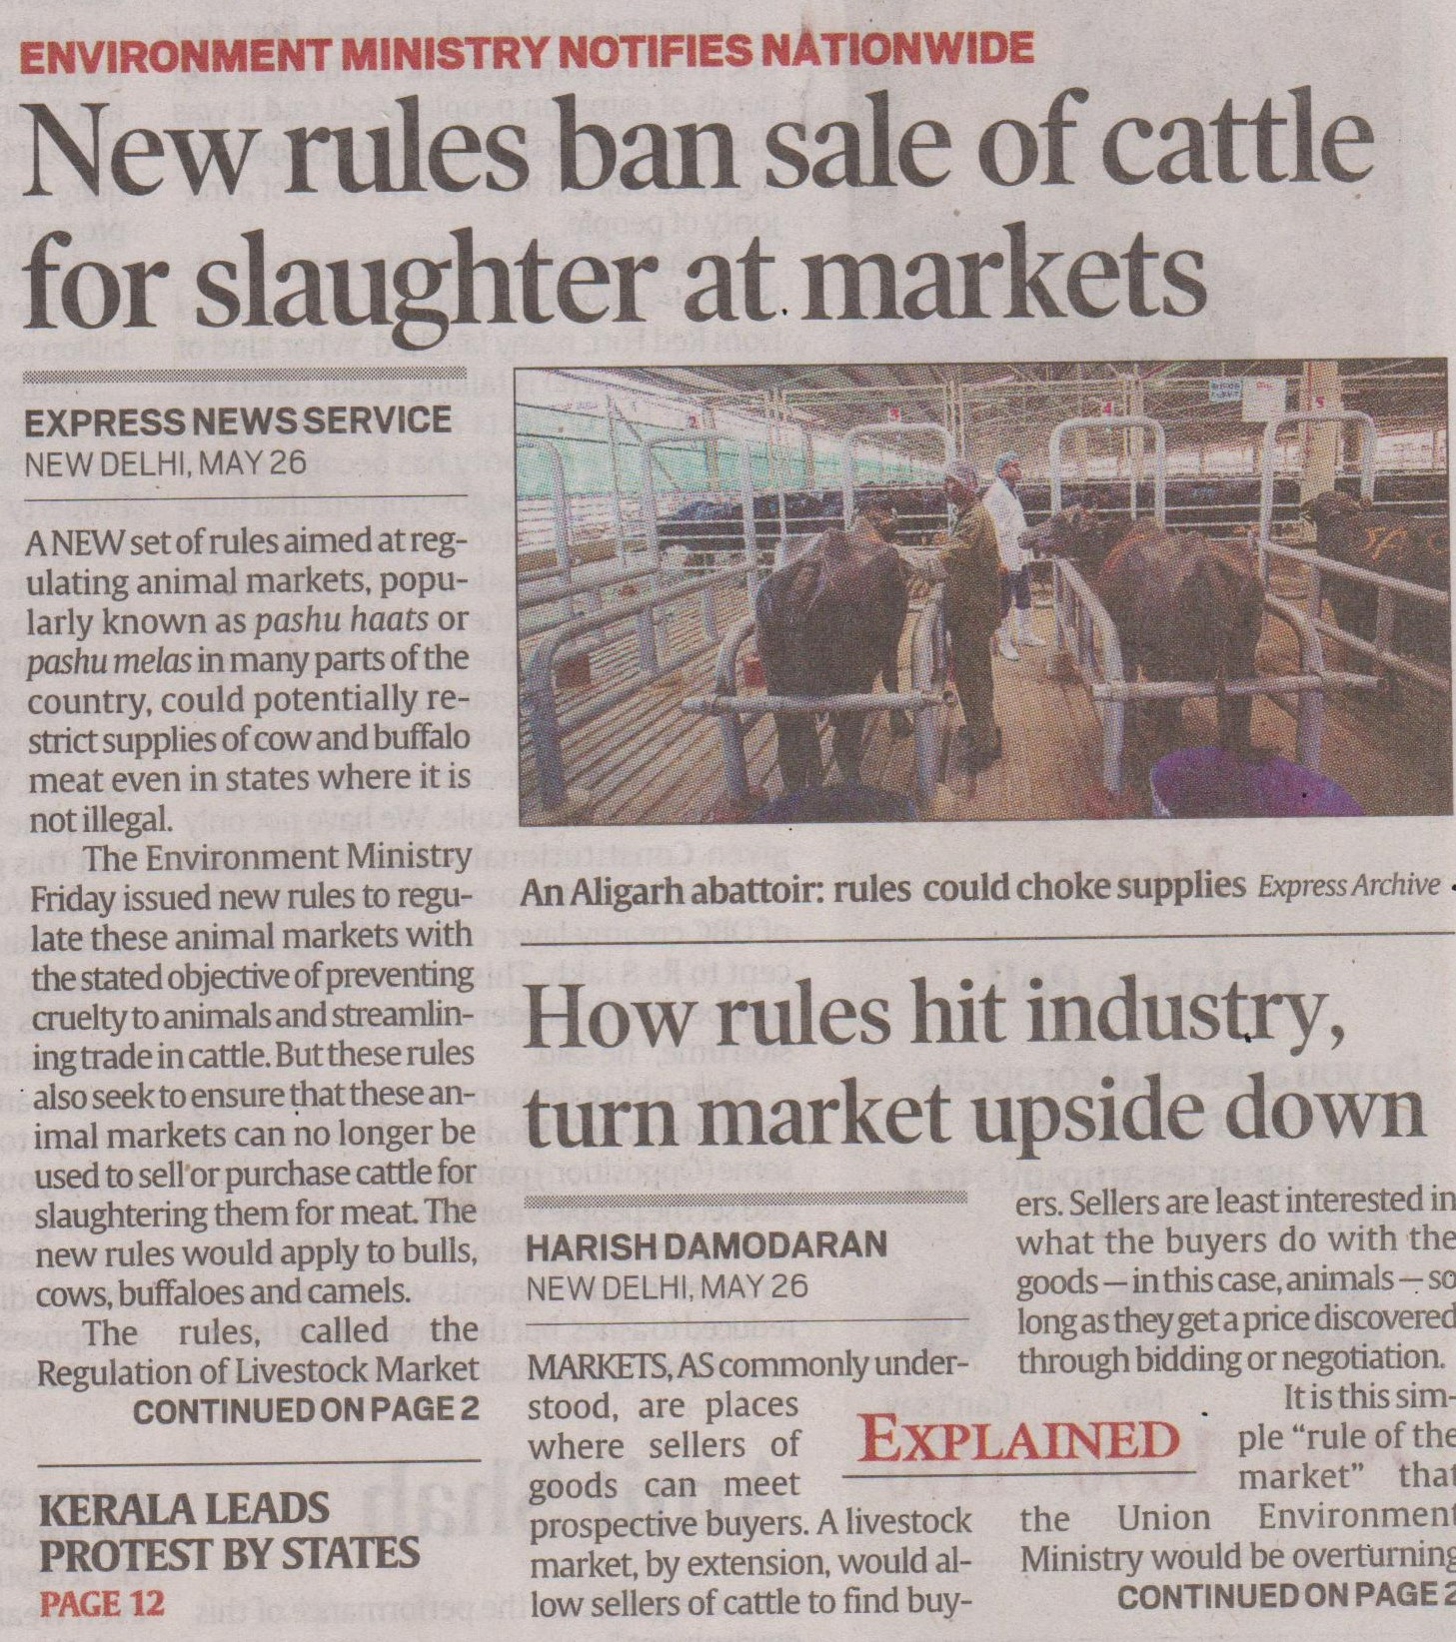

Slide 18
Board , Committee , Jury , Team , Government , Management are both
singular and plural

Slide 19
sheep , fish , deer , species , offspring , aircraft , spacecraft remain the same both for singular and plural.

Slide 20
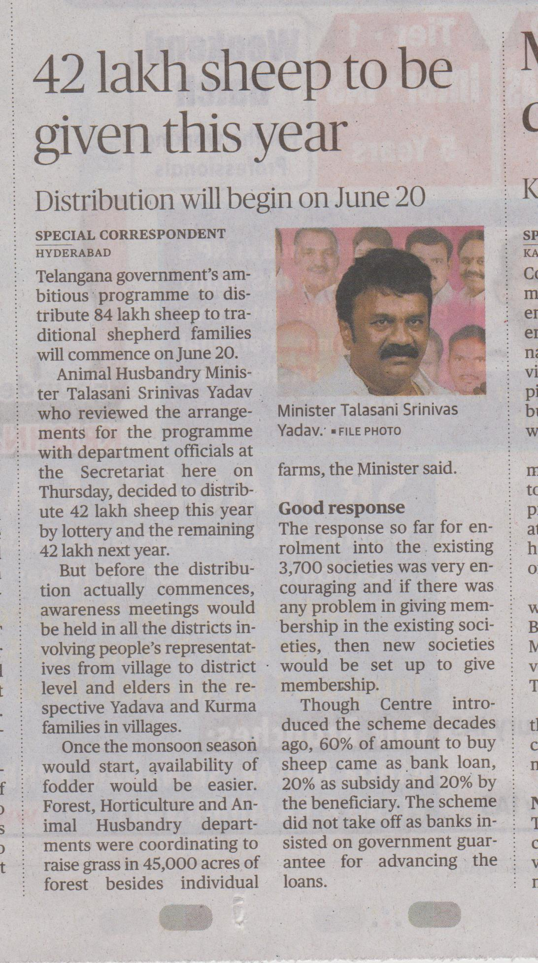

Slide 21
Questions from work book
1. The scenery of Kashmir___(is/are) enchanting.
2. Where____ (is/are) the scissors?
3. The cattle ___ (is/are) grazing in the ground.
4. The clergy ___ (has/have) visited the church.
5. He is six ____ (feet/foot) tall.

Slide 22
6. I want _____ (an advice/a piece of advice) from you.
7. One must take care of _____ (his/one's) own health.
8. Four ____ (hundreds/hundred) miles is a long distance.
9. The manager asked me _____ (a cheque/ a leaf of
cheque).
10. The _____ (off-springs/off spring) of animals are
very much dependent on mothers for survival.

Slide 23
Dozen , hundred , thousand , lakh , million , crore are expressed in singular when used with a definite number .
Five hundred students wrote the mock test .
Hundreds of students wrote the mock test .
Several / many /few hundreds of students.

Slide 24
1. The leaders of our party (A) in this region are not (B) in good terms of each other. (C) No error (D)
2. The analysises of the (A) organization are (B) very reliable. (C) No error (D)
Each other : 2 one another : 3 / 3+

Slide 25
singular
plural
A N A L Y S I S
A N A L Y S E S
C R I S I S
C R I S E S
S Y N O P S I S
S Y N O P S E S
T H E S I S
T H E S E S

Slide 26
GENDERS
MASCULINE : MALE
FEMININE : FEMALE
COMMON : THAT APPLIES FOR BOTH MALE AND FEMALE
NEUTER : THAT HAS NO GENDER

Slide 27
Common genders : baby / kid / child / student /teacher / lecturer / professor / sibling / parent / cousin/person etc .
* We cannot say Cousin brother / cousin sister though this rule is grossly violated .

Slide 28
3. Females (A) are not appointed (B) in our college. (C) No error (D)
4. The table's legs (A) have been (B) elaborately carved. (C) No error (D)

Slide 29
FEMALE CANDIDATES / TEACHERS / EMPLOYEES / STAFF MEMBERS CAN BE USED .
SIMPLY “ FEMALE OR FEMALES “ IS WRONG , IT IS DISCORTEOUS TO MENTION SOMEONE BY THE GENDER .

Slide 30
My shirt’s collar
The collar of my shirt
The legs of the table have been elaborately carved

Slide 31
RULE
The possession of a non living thing cannot be shown by using APOSTROPHE AND S

Slide 32
EXCEPTION
TIME : yester day’s programme , today’s class .
ORGANIZATIONS : R.B.I.’s decision , Micro soft’s C.E.O.
PLACES: America’s president , Bihar’s election.
Books and movies

Slide 33
APOSTROPHE IS USED AFTER ‘ S ‘ WHEN WE SHOW THE POSSESSION OF A PLURAL SUBJECT.
This boy’s car
Boys’ hostel
Our minister’s decision
Our ministers’ decision

Slide 34
Thomas’
James’
Tiger woods’
Charles’
If the name itself ends with S , we use APOSTOPHE after S

Slide 35
5. This misogynist hates (A) all mother in laws (B) lady doctors and house maids. (C) No error(D)
6. There are so many filths (A) all around (B) the place. (C) No error (D)
5th . Ans : B – mothers in law

Slide 36
SINGULAR
PLURAL
Passer – by passers – by
Mother – in -- law Mothers – in law
Father- in--law
Fathers – in -- law
Brother – in– law Brothers – in--law
Sister -- in -- law
Sisters – in -- law

Slide 37
There is so much filth
Many is used with countables
Much is used with uncountables

Slide 38
7. The company has ordered (A) some (B) new equipments. (C) No error (D)
8. Science and religion (A) are both necessary for man and for their (B) outer and innerself respectively. (C) No error (D)
Answer for 8th question : his in place of their
The pronoun for a noun called man is “ his “ .

Slide 39
One of the (A) most dangerous ( B) disease is AIDS. (C) No error (D)
Answer : diseases in place of disease
Plural object
One of
Singular verb
Singular pronoun

Slide 40
Please do not encourage beggars who exploit children .
Srinivas
Sahana foundation
www.sahanafoundation .net

Slide 41
TENSES AND VOICE

Slide 42
Simple present tense
Habitual Actions
Universal Truths
Planned Actions

Slide 43
am
Is
are
Sub + Vɪ + Obj
I teach English
English
is
taught
by
me

Slide 44
Key words
often , usually , frequently ,
regularly , now and then ,
rarely,
daily, every.

Slide 45
Present Continuous Tense
Action that is in progress at present.
Action that is certain to take place.
Action in general.

Slide 46
Keywords : now , right now ,
At present , presently , currently .

Slide 47
Sub + am/ is/ are + V4 + Obj
He is writing a novel.
am
Is + being
are
A novel
is
being
written
by
him.

Slide 48
Present Perfect Tense
Action that has just happened.
A past action without time.
An incomplete action.

Slide 49
Sub + have/has + V3 + Obj
He has informed them.
They
have been
informed
by
him.
have
has
+ been

Slide 50
Key words
Just , just now , recently ,
So far , yet , already, this week/month/year

Slide 51
Didn’t yet
Have/has + not + yet

Slide 52
Present Perfect Continuous Tense
Action that started in the past and is still going on.
[ Time is given importance ]
No passive voice

Slide 53
Key words
For , since .

Slide 54
Sub + have been/has been + V4+ Obj + Time
I have been preparing the material.

Slide 55
Simple Past Tense
A past action with time.
Sub + V2 +Obj + Time

Slide 56
Key words
Any word that refers to past .

Slide 57
He finished the work yester day.
The work
was
finished
by
him
yester day.
was/were

Slide 58
Past Continuous Tense
Action as going on in the past .
Sub + was/were +V4 + obj + time

Slide 59
When ever I saw him he has been reading the same novel.
Had been reading (2) is reading
(3) was reading (4) No Improvement
Answer : 3
(CDS 2014)
The combination of past continuous and simple past tenses .

Slide 60
He was interviewing them at 4p.m.
They
were being
Interviewed
by
him
at 4p.m.
Was
Were
+ being

Slide 61
Past Perfect tense
Action that takes place prior to another in the past .

Slide 62
Key words
Already , when , before , after .

Slide 63
Sub+ had +V3 + obj + when/before + sub +V2 + obj
He had deceived us before you came here.

Slide 64
we
had been
by
deceived
him
before you came here.
Had + been

Slide 65
Past perfect continuous tense
Action that lasted for some time in the past.
(time is given importance)

Slide 66
Sub + had been + V4 + obj + time
He had been living in the U.S. for six years before shifting to the U.K.
( no passive voice )

Slide 67
Simple future tense
Action that is yet to take place
Sub + shall/will+V1 +obj + time

Slide 68
I , we : shall
Simple futurity
All persons: will
Simple futurity
2nd , 3rd persons : shall
compulsion

Slide 69
She will receive the guests at the airport tomorrow.
Shall
will
+ be
The guests
will be
received
by her
at the airport tomorrow.

Slide 70
Future Continuous Tense
Action as going on in future.
Sub + shall be /will be + V4 + obj +time
He will be travelling tomorrow at 7p.m.
No passive voice

Slide 71
Future Perfect Tense
Action as finished in future.
( before a particular time or an action )
sub + shall have / will have +V3 + obj + time

Slide 72
He will have submitted the file by 20^{th.}
The file
will have been
submitted
by
him
by 20th.
Shall have
Will have
+ been

Slide 73
Usage of by in passive voice is optional not a must . In fact sometimes we need to avoid by which gives the information about the doer of the action .
Ex : English is spoken by people in many parts of the world
it is known that only people speak languages hence we need to avoid “ by “

Slide 74
If a ” be “ form or a ” get “ form is immediately followed by the third form of the verb it is passive voice

Slide 75
AM
IS
ARE
WAS
WERE
BE
BEING
BEEN
Get
got
+ V3 = PASSIVE VOICE
got

Slide 76
IMPERATIVE SENTENCES :
Do it : Let it be done .
Do not do it : Let it not be done .
Finish the work : let the work be finished
Do not waste your time : let your time not ne wasted

Slide 77
Imperative sentences express : requests / suggestions / advice / commands .
They begin with verbs not with the subjects unlike other sentences , in fact the subject is the person listening .

Slide 78
GERUND

Slide 79
A
Verb used as a noun is called a gerund
1 . It acts as a subject to a verb
2 . It acts as a complement in a sentence
3 . It is used with some specific words .
a preposition is followed by GERUND

Slide 80
ENJOY , MIND , MISS , AVOID , REMEMBER , WITH A VIEW TO , CANNOT HELP , COMMITTED TO , LOOK FORWARD TO , BE HABITUATED TO , BE ACCUSTOMED TO , BE ADDICTED TO , BE USED TO , FOND OF , CAPABLE OF , INTERESTED IN , INSIST ON , KEEP , KEEP ON , BE WORTH , STOP , PREVENT , DISLIKE , BE NO GOOD , TIRED OF , ADMIT TO ETC. TAKE
GERUND

Slide 81
My friend worked ( 1 ) hard with a view to pass ( 2 ) the examination( 3 ) / no error ( 4 )
ESE 2015
It should be “ passing “

Slide 82
S . S . C . STATISTICAL INVESTIGATORS EXAM . 31 / 07 / 2005
She doesn’t mind to be disturbed .
( 1 ) being disturbed ( 2 ) to being disturbed
( 3 ) being disturbing
( 4 ) No improvement
( 1 ) is correct
Be – was – been – being are the four forms of the verb

Slide 83
S . B . I . ( PROBATIONARY OFFICERS ) EXAM 2013
We are eagerly looking forward to receive the chief guest at the airport
( 1 ) received ( 2 ) be receiving
( 3 ) receiving
( 4 ) no improvement
Answer : ( 3 ) receiving

Slide 84
QUESTION TAGS
Question tags are the short questions that we put at the end of the sentences , they are used for confirmation of the statements that we make .
We need to keep three points in mind while using question tags
SUBJECT ?
TENSE ?
KIND OF SENTENCE ?

Slide 85
If the sentence is positive , question tag should be negative , if the sentence is negative , the question tag should be positive .
Use a helping verb according to the tense of the sentence .
Use a pronoun based on the subject .

Slide 86
If the subject of the sentence is an indefinite pronoun , then the subject of the tag will be THEY .
EX : some one called you , didn’t they ?
None can prove it , can they ?
let us : shall we ?
let him/her/them : will you ?
I am : aren’t I ?

Slide 87
IMPERATIVE SENTENCES
Do it : will you ? / won’t you ?
Do not do it : will you ?

Slide 88
WORK BOOK PAGE NO . 105
1. mohan has already come , ___________ ?
2 . She can swim well ____________ ?
3 . Mohan doesn’t work hard , ______________ ?
4 .They haven’t come yet , __________ ?
5 . There are some girls in your class, __________ ?
6 . They haven’t taken the material, ___________ ?
7 . Made easy has several branches , _____________ ?

Slide 89
1 . I needn’t get up early tomorrow , ___________ ?
2 . Lets go to the beach , ______________ ?
3 . Some body has called , _______________ ?
4 . Few students attended the party , ______________ ?
5 . She won’t receive the guests tomorrow , ___________ ?
6 . The performance was exceptionally impressive , ______ ?
7 . He never sleeps in the afternoon , ___________ ?

Slide 90
Page no . 105
1 . Neither of them has completed the task , __________ ?
2 . We must follow the rules , _________________ ?
3 . None of the students has attended the class, ________ ?
4 . He has been preparing for the examination since 2014, _________________ ?
5 . Little progress was made , ________________ ?
6 . It’s obvious that they are trying to cheat us , __________ ?
7. My father suggested that I should be more serious towards my career ,_______________ ?

Slide 91
concord

Slide 92
Two singular nouns joined with “ and “ take the plural verb → are / were / have / have been
Ravi and Raju have started the business

Slide 93
Two singular nouns joined with “ and “ referring to the same person take the verb in singular form.
has
My friend and colleague have come to my house.

Slide 94
Two singular nouns joined with “ and “ together expressing one idea take the verb in singular form.
(
Pair words
)
Slow and steady
Time and tide
Age and experience
Cup and saucer
Horse and carriage
Name and fame
Rise and fall
Soup and salad

Slide 95
GATE 2013 EC + EE +IN
CHOOSE THE GRAMMATICALLY CORRECT SENTENCE :
( A ) Two and two add four
(B ) Two and two become four
( c ) Two and two are four
( D ) Two and two make four

Slide 96
Answer is “ D “
In the absence of makes , make is correct .

Slide 97
Two singular nouns joined with “and “ preceded by each or every take verb in singular form.
was
Every man and every woman were surprised at the result.
is
Each minute and each hour are valuable in life.

Slide 98
In sentences having either - or , neither- nor, not only – but also the verb must agree with the subject that is after or/nor/but also
has
Either you or he have to finish this work .

Slide 99
When we have a connective like
With, Together with, Along with, As well as,
In addition to, Besides,
But , Rather than,
accompanied by, apart from, aided by,
The verb must agree with the subject before the connective.

Slide 100
The students as well as their teacher is waiting.
are

Slide 101
Expressions like
one of
None of
either of
neither of
every one of
Noun
↓
Plural
Verb
↓
singular
take

Slide 102
The verb in a sentence must always agree with the real subject not with the dummy subject.
The beauty of those flowers have attracted me.
has

Slide 103
The verb that follows “here there “ depends on the noun that follows the verb.
There is a boy
There have been many questions.

Slide 104
“A number of “ takes plural verb
“The number of” takes singular verb .

Slide 105
many a → singular
many/ a good many/ a great many →plural

Slide 106
When ever a gerund is the subject, the verb is put in singular
Reading news paper improves language skills.

Slide 107
The verb that follows a fraction depends on the noun that follows the fraction.
Ex :
Half of his work is left.
Half of the students are not sure of the answer.

Slide 108
Several/many/ few always take plural subjects and plural verbs.
Someone ,somebody, anyone ,any body , none , nobody ,either , neither always take singular verbs.

Slide 110
Questions from work book
1 . The college board as well as the local citizens ( a ) were pleased ( b ) with the plans for the new college ( c ) no error (D )
2 . The intelligence ( a ) of many wild animals is ( b ) indeed amazing ( c ) no error ( d )

Slide 111
3. Every man , woman (a) and child were (b) taken from the town (c) no error (d)
4. Either a certified cheque on deposit ( a ) or a valid major credit card is required ( b ) for one to bid on the goods (c) no error(d)

Slide 112
5. One of these detergents have (a) proved to be harmful (b) to the delicate skin of the house wife (c) no error (d)
6. None of the soldiers (a) was able to pass (b) the physical fitness test (c) no error (d)

Slide 113
7. The principal was pleased to learn (a) that none of the foreign students was (b) majoring in education of chemistry(d)
8. Here comes (a) the trainers and the players (b) for both teams(c) no error(d)

Slide 114
9. Each organization has its (a) own selected officers (b) who conduct the business of the organization (c) no error(d)
10. This master book concludes with pages (a) that contain lists (b) of American colleges and universities (c) no error(d)

Slide 115
Page no. 105 subject verb agreement
1. Rahul’s natural ability and his desire to help others HAS / HAVE led to a career in the ministry .
2. Everybody who signed up for the ski trip WAS / WERE taking lessons

Slide 116
3. Some of our luggage WAS/ WERE lost
4. None of his advice MAKE / MAKES SENSE .
5 . One out of every three sunsets WAS / WERE covered with clouds .
6. The teeth in a crocodile’s mouth IS / ARE sharp

Slide 117
7. The leaders of the expedition WAS/ WERE looking for a camp site
8. During the trip bread and butter WAS / WERE the favourite meal for the two drivers .

Slide 118
9. On the side IS / ARE political correspondents hoping for an interview .
10. The trunk of the elephant and the belly of the hippo MAKE / MAKES me laugh .

Slide 119
Conditionals

Slide 120
Type - 1
If + sub + V1 + Object →
sub + shall / will / can / may
+ V1 + Object
If I take coaching , I will get good marks
FUTURE
50%

Slide 121
Type -2
If + sub + V2 + Object →
sub + should / would / could / might
+ V1 + Object
If I took coaching , I would get good marks

Slide 122
Type - 3
If + sub + had + V3 + Object →
sub + would / should / could / might + have + V3 + Object
If I had taken coaching , I would have got good marks.
PAST 0%

Slide 123
2nd way of type 3 conditional
Had + sub + V3 + obj + sub + would have + V3 + obj
Ex :
Had you asked me , I would have helped you
( I did not help you because you did not ask me )

Slide 124
Type 4
If + sub + V1 + Object →
sub + V1 + Object
FACTS
100 %

Slide 125
Negatives of conditionals
If you do not ask me , I will not help you
If I do not take coaching , I will not get good marks

Slide 126
If I did not take coaching , I would not get good marks
If you did not ask me , I would not help you

Slide 127
If I had not taken coaching , I would not have
got good marks
If you had not asked me , I would not have
helped you

Slide 128
Prepositions

Slide 129
clock , 9-15 )
AT : time ( 10
0
( at noon and at night )
ON : days ( Sunday ) and dates ( 15TH )
IN : parts of the day ( morning ) / months ( march ) , years ( 2015 ) / seasons ( winter )

Slide 130
on
upon
: static ( They are in the garden )
IN
: with movement ( They ran into the garden )
INTO

Slide 131
Between - Among
2
3/3+
Ex :
There are some disputes between the two brothers
Ex : Distribute the sweets among the children

Slide 132
AT : COMPARATIVELY SMALL PLACE .
IN : COMPARATIVELY LARGE PLACE
AT : NEARNESS
IN : EXACT LOCATION
He is at the library ( near )
Ex :
He is in the library ( may be , he is reading )

Slide 133
By : the doer of the action
With : the instrument
Ex :
The land was ploughed by the farmer with the help of a tractor .

Slide 134
AGREE WITH : someone
Agree to : something
Agree on : terms and conditions

Slide 135
In : at the expiry of time
Within : before the expiry of time
Ex :
I shall return your money in a week
on the seventh day ( last day of the week )
Ex :
I shall return your money within a week
On any one of the next six days

Slide 136
FOR ---- SINCE
Period of time
Point of time

Slide 137
PERIOD OF TIME : THAT CAN BE COUNTED IN NUMBER . ( FROM SECONDS TO CENTURIES )
FEW , SEVERAL , MANY , A LONG TIME , A LOT OF TIME .
POINT OF TIME : THAT CANNOT BE COUNTED IN NUMBER , ONLY IDENTIFIED .

Slide 138
ESE 2015
Have you seen ( a ) / any films lately ?( b ) / “Not since the last few months “( C ) no error (D)
Answer : C ( for in place of since )
Though last is used we need to take for because of few .

Slide 139
Enter - moving in ( physically )
He entered my room without permission
To be a part of / join he entered politics last year
ENTER INTO : INVOLVE
Discussion / argument / agreement / contract / deed
They entered into a heated argument with their leader .

Slide 140
Jealous
Fond
Aware
Beware
Suspicious
Proud
Boast
Of

Slide 141
Accuse
Guilty
Convict
Acquit
Of

Slide 142
Refrain
Stop
Prevent
Prohibit
Dissuade
Abstain
From
People should be prohibited from smoking in public .
He stopped me from going there .

Slide 143
Of
: physical blindness
Blind
To
: mental blindness
He is blind of one eye
We should not be blind to our weaknesses

Slide 144
with
: someone
Angry
AT
: something
Ex : my brother is angry with me at my laziness

Slide 145
Good
Bad
Clever
Poor
False
At

Slide 146
Sympathy Antipathy
Passion Aptitude Love
Liking Hatred
cure
For

Slide 147
We were discussing about politics when he called up
Discuss does not take a preposition , it is directly followed by the object
But discussion ( the noun form ) is used with prepositions .

Slide 148
DISCUSSION :
ABOUT
: AT LENGTH
DISCUSSION
:
ON
: IN SHORT

Slide 149
Attend: to be present physically
I need to attend a meeting tomorrow
Attend to : to take care of / to pay attention
She had to attend to her mother who was ill.

Slide 150
Wait : we use for after it
We are waiting for the results
Await : we do not use for after it
We are awaiting the results

Slide 151
Page 106
1. There is no cure ____ AIDS.
2. I am suspicious ____ his intensions.
3. The lecture was accompanied _____
subtle analysis of concepts .
4. Life is compared ____ a battle.

Slide 152
Page 106
5. We are responsible ___ God ___ our
actions.
6. You are prohibited ____ taking
photographs.
7. We must have the ability to cope ____
adverse situations in life .

Slide 153
Moderate level: Fill in the blanks;
1. The British could conquer India because the
Indian kings were fighting ___ themselves.
(a) among (b) between (c) with (d) for
2. The history of Hindu religion dates ____
ancient times.
(a) from (b) since (c) for

Slide 154
3. No one believes him because he is
false _____ heart.
(a) to (b) at (c) of
4.Cooperation between friends stems
_____ mutual consideration .
(a) is (b) out (c) from

Slide 155
5. In fact there is no library in our town to
speak _____.
(a) for (b) about (c) of
6. Dishonesty is always detriment
_____ progress.
(a) to (b) for (c) of

Slide 156
7. In the long run, drinking proved fatal both
____ his reputation and health.
(a) for (b) to (c) of
8. Disintegration of the country is inimical
_____ the progress of the people.
(a) to (b) for (c) from

Slide 157
He has great antipathy _____ those
who are hypocrites.
(a) for (b) to (c) against
10. As a dancer she has aptitude ____
classical system.
(a) for (b) to (c) in

Slide 158
On a holiday (A) Madhu prefers reading (B) than going out visiting friends. (C) No error (D)
My brother (A) has ordered (B) for a new book. (C) No error (D)

Slide 159
My niece has been (A) married with(B) the richest man of the town. (C) No error (D)
All the doctors were(A) puzzled on the strange symptoms (B) reported by the patients.(C)
No error (D)

Slide 160
verb
Marry
Married Married
object
adjective
Be + married
To + object
noun
Marriage + with object

Slide 161
Puzzled , shocked , surprised , astonished
At

Slide 162
When he parted with his sister(A) at
London airport (B) there were tears in his eyes. (C) No error (D)
He was honorably (A) acquitted from (B) the charge. (C)
No error (D)

Slide 163
7. He was very much engaged (A) in his work when the thieves (B) entered into his house (C) and took away a lot of things. (D) No error (E)
8. Somebody reported to me (A) that a boy has fallen (B) in the well and nobody had (C) tried to save him (D) No error (E)

Slide 164
9. He wants to resign (A) his job because (B) he is unable to (C) cope up with the work pressure at the office (D)
No error (E)

Slide 165
He could not cope up with the heavy rush.
cope with (b) cope by
(c) cope up to (d) No improvement
(ESE-2012)

Slide 166
Cope is followed by only with
Answer : a

Slide 167
INSPITE ------ DESPITE
Inspite takes of after it , despite does not take the preposition .
CONSIST ----- COMPRISE
Consist takes of , comprise does not take of
COMPRISED TAKES “ OF “ IN PASSIVE VOICE
IT IS COMPRISED OF A LOT OF THINGS

Slide 168
10. Despite of curfew (A) in some areas, minor (B) communal incidents were reported (C) from different areas of the walled city (D) No error (E)
SOURCE : IBPS EXAM
Answer : a

Slide 169
Idioms

Slide 170
Add fuel to the fire : to make a problem worse
Bad blood : hostility / hatred between people
Blue blood : of a noble / royal family
Cake walk : a very easy task
Grease someone’s palm : to bribe someone
Spick and span : neat and clean
Fit as a fiddle : very healthy and full of energy
Bury the hatchet : to make peace / to end the rivalry and start a good relation

Slide 171
Break the ice : to speak first after a prolonged silence
Bring to book : to punish
Breathe one’s last : to die / pass away
Bolt from the blue : sudden shock
Blow one’s own trumpet : to praise the self
Burn one’s fingers : to get into trouble
Lion’s share : the largest part of something
Tip of the iceberg : only a hint of a much larger problem/issue
Bolt from the blue : unexpected shock

Slide 172
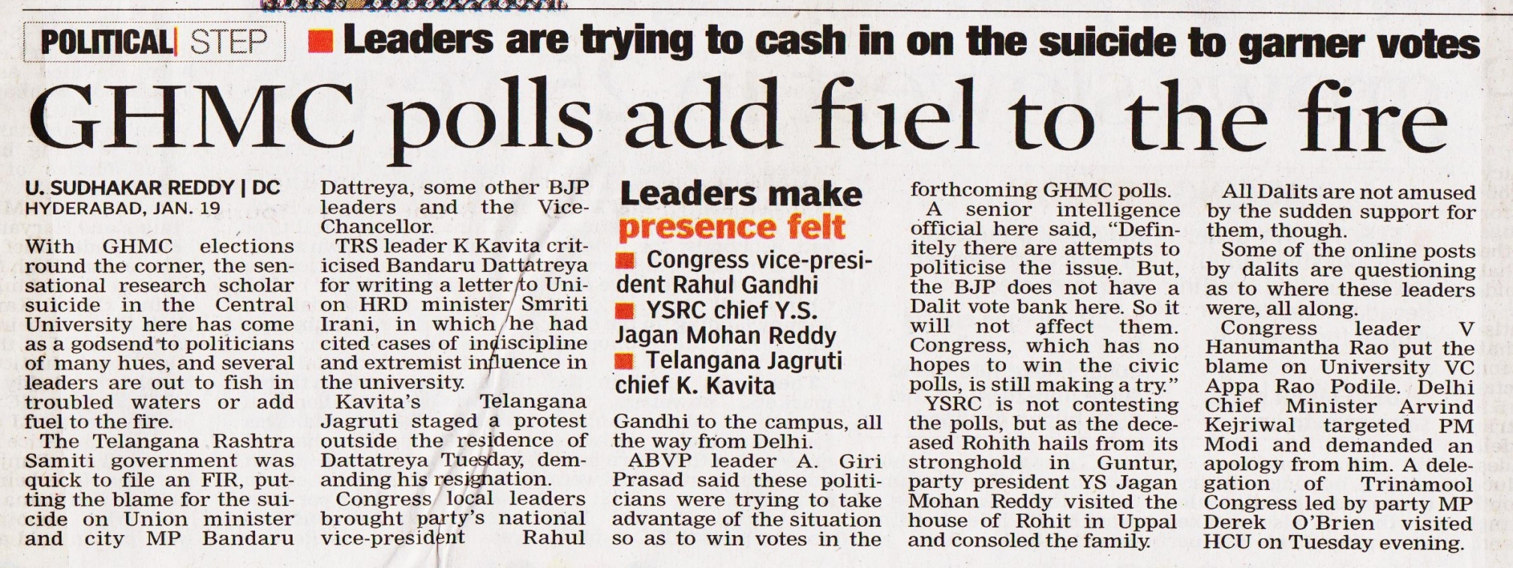

Slide 173
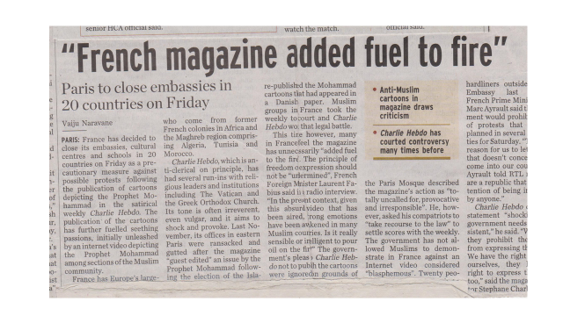

Slide 174
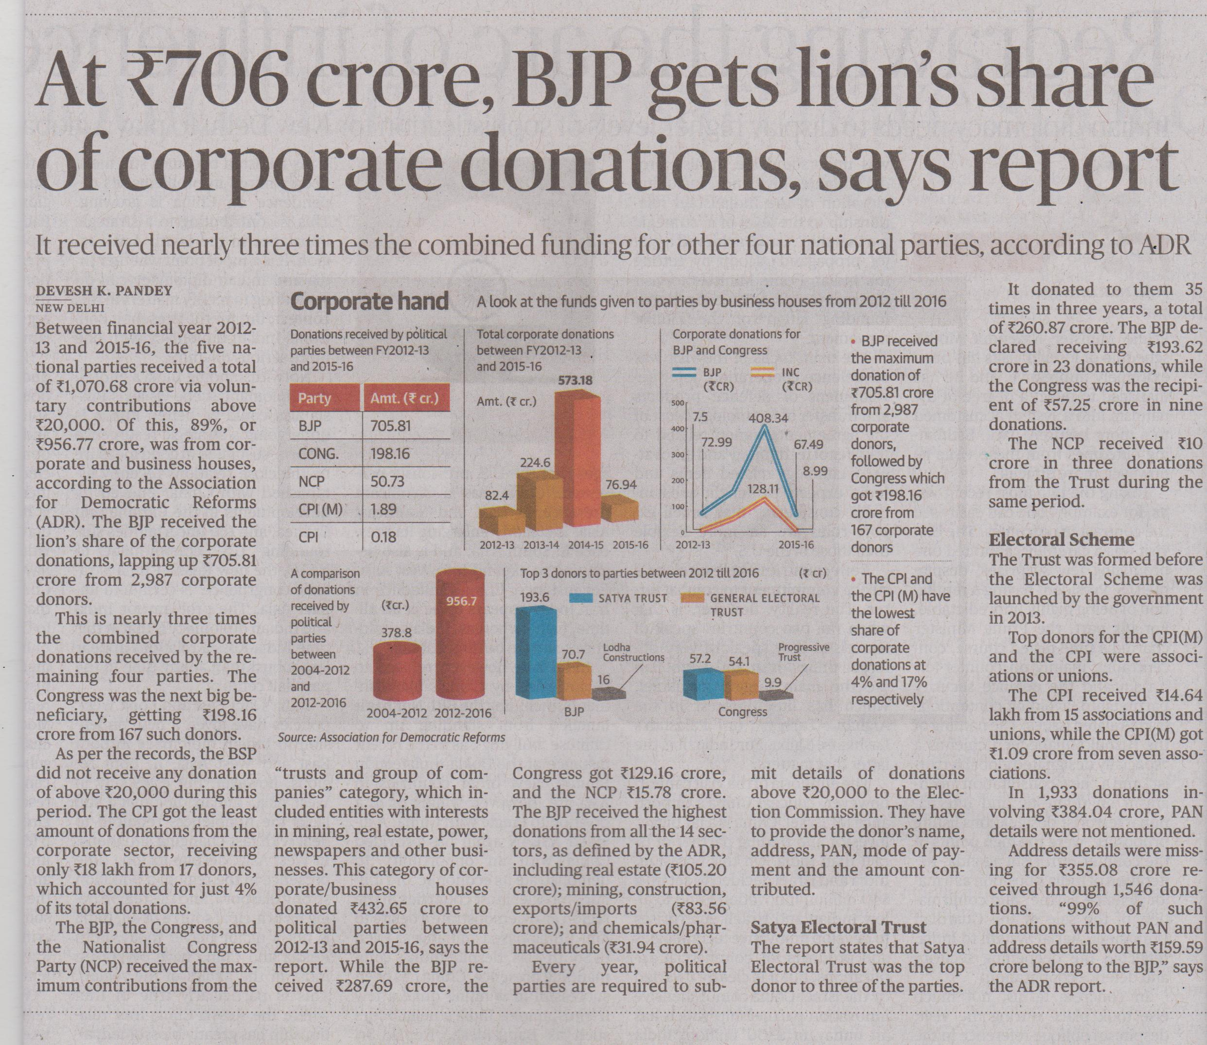

Slide 175
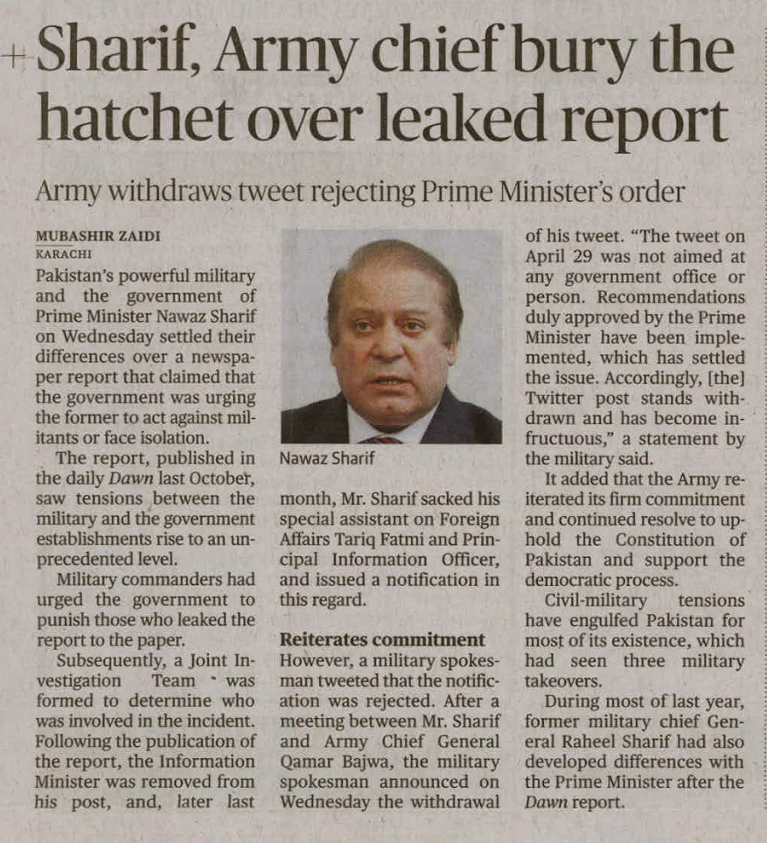

Slide 176
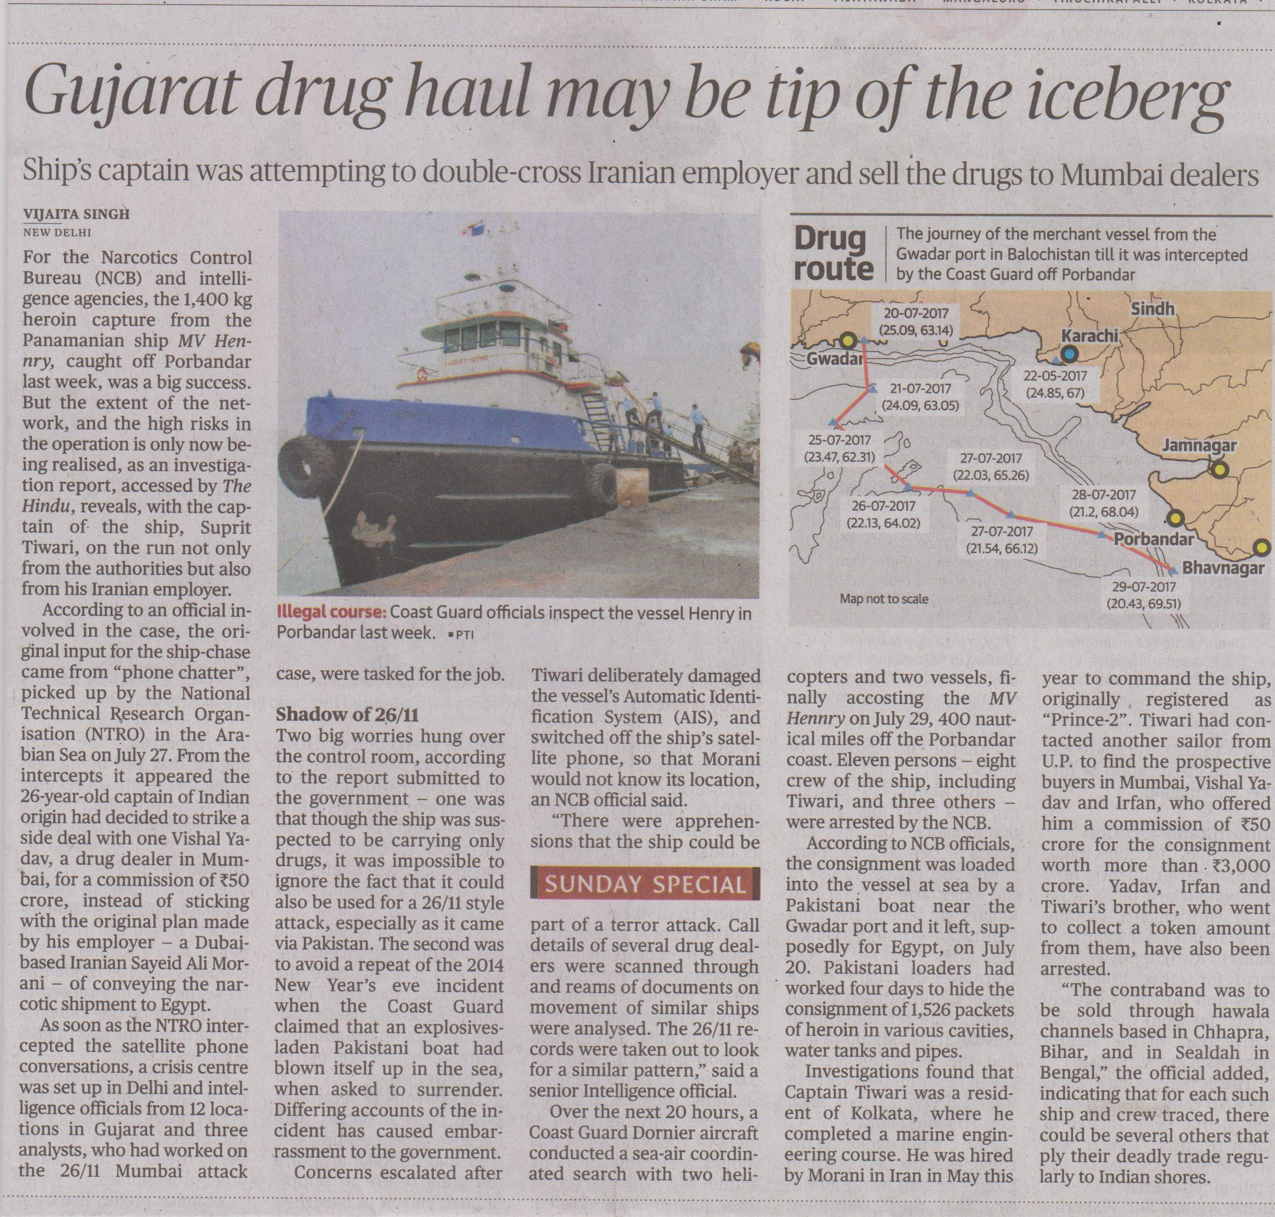

Slide 177
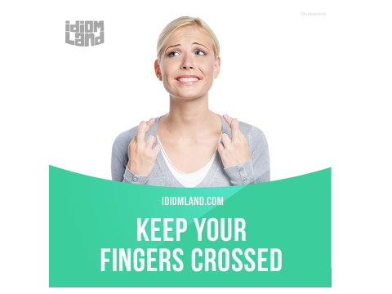

Slide 178
Keep one’s fingers crossed : to wish / hope for luck .
Ex : students keep their fingers crossed before the results .
A wolf in a sheep’s clothing : a person who looks harmless but is actually dangerous .
Ex : most of the politicians are wolves in sheep’s clothing
Feather in one’s cap : an achievement that one takes pride in .
Bird’s eye view : a large view / comprehensive perspective

Slide 179
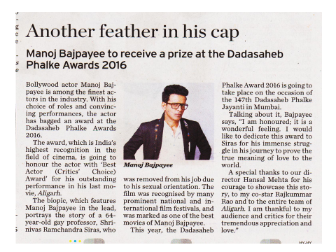

Slide 180
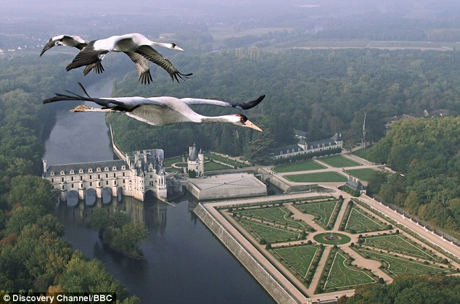
Bird’s eye view

Slide 181
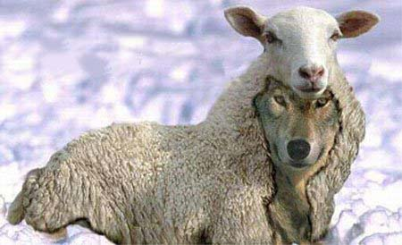
A wolf in a sheep’s clothing

Slide 182
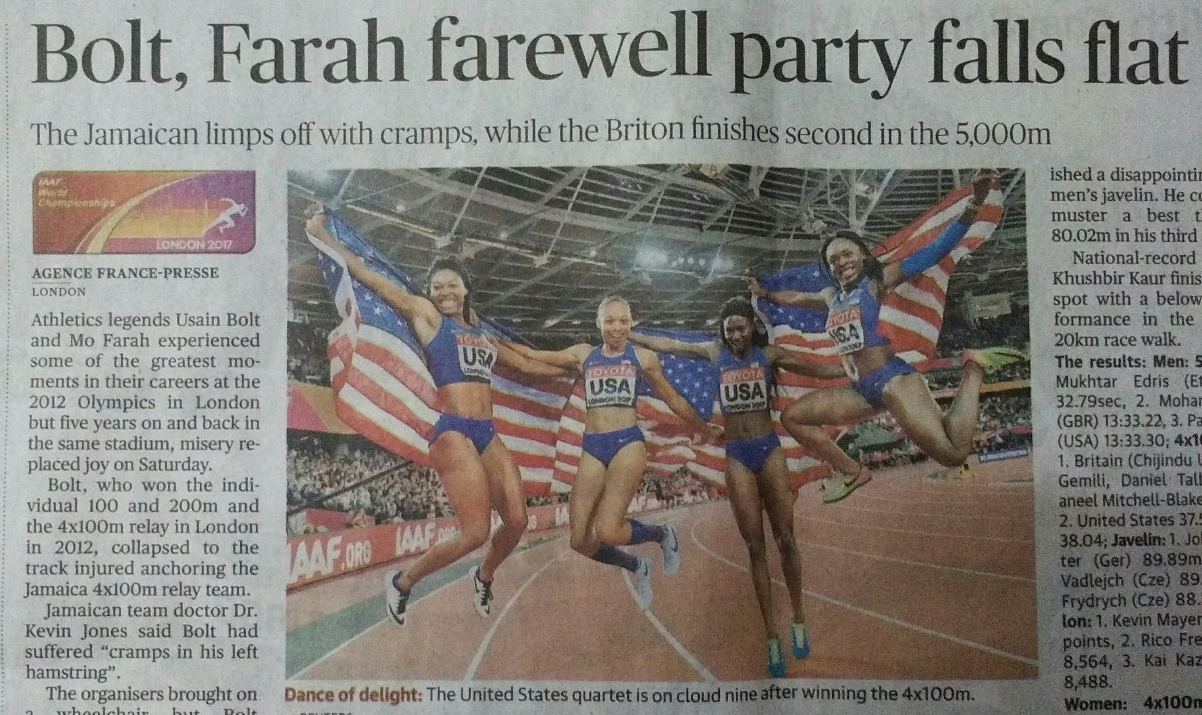

Slide 183
Old habits die hardly. (ESE-2012)
(a) die hard (b) die too hard
(c) die much hardly (d) No improvement
Answer : A

Slide 184
He turned a deaf ear to my request .
What does the underlined phrase mean?
ignored (b) appreciated
(c ) twisted (d) returned
GATE 2016 CE ,Set - II
Answer : a

Slide 185
GATE 2016 C E SET : II
Choose the most approprite set of Words.
____ ____ Is a will , ____ is a way .
Wear , there , their
Where, their, there
Where, there, there
Were, their , their
Answer : c

Slide 186
We should keep (a) such people (b) at an arm's length. (c) No error (d)
E S E 2012
Answer : c ( at arm’s length )

Slide 187
Any meaningful discussion of national integration (a) must take stock about the tendencies (b) which threaten it. (c) No error. (d)
ESE 2010
Answer : b ( to take stock of )
Take stock of : assess / evaluate .

Slide 188
She wanted to be an actress, (a) but her father soon (b) nipped that idea in the bud. (c) No error. (d)
ESE 2008

Slide 189
Select the alternative meaning of the underlined part of the sentence.
The chain snatchers took to their heels when the police party arrived.
Took shelter in a thick jungle
Opened indiscriminate fire
Took to flight
Unconditionally surrendered
GATE 15 CS+IN

Slide 190
That boy from the town was a ……… in the sleepy village .
(a) dog out of herd (b) sheep from the herd (c) fish out of water (d) bird from the flock
GATE 2015 C S + I N

Slide 191
S . S . C . ( INCOME TAX ) EXAM 11 / 12 / 2005
As I am new to the place I felt like a fish in water
( 1 ) felt like a fish in the water
( 2 ) felt like a fish with water
( 3 ) felt like a fish out of water
( 4 ) No improvement

Slide 192
PHRASAL VERBS

Slide 193
A SIMPLE VERB FOLLOWED BY A PREPOSITION OR AN ADVERB.
TAKE UP : TO ACCEPT A RESPONSIBILITY .
TAKE ON : TO COMPETE .
TAKE DOWN : TO NOTE DOWN .
TAKE AFTER : TO RESEMBLE .
TAKE IN : TO UNDERSTAND .

Slide 194
TAKE OVER : TO TAKE CONTROL .
TAKE SOME ONE THROUGH : TO EXPLAIN SOME THING TO SOME BODY IN DETAIL .
TAKE OFF : TO START .
TAKE PART : TO PARTICIPATE / JOIN IN

Slide 195
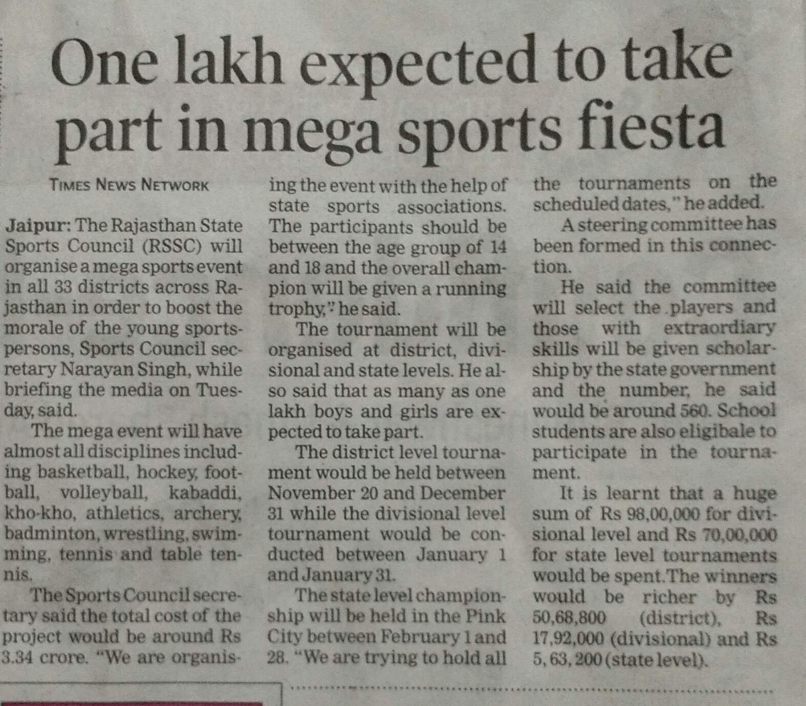

Slide 196
PUT
PUT UP : TO ESTABLISH / STAY
PUT OFF : TO POSTPONE
PUT FORTH / FORWARD : TO OFFER AN IDEA / PLAN
PUT ON : TO WEAR
PUT OUT : TO EXTINGUISH
PUT UP WITH : TO SUSTAIN
PUT DOWN : TO WRITE DOWN .
PUT OFF : TO POST PONE
PUT OFF : TO RID ONESELF OFF

Slide 197
GATE : 2016 EE + CS
Nobody knows how the Indian cricket team is going to cope with the difficult and seamer - friendly wickets in Australia .
( A ) PUT UP WITH ( b ) PUT IN WITH ( c) PUT DOWN TO ( d ) PUT UP AGAINST
Answer : ( a )

Slide 198
GATE 2013 EC + EE + IN
They were requested not to quarrel with others
Which one of the following options is the closest in meaning ?
A . MAKE OUT B . CALL OUT C . DIG OUT D. FALL OUT
( d ) is the answer( meaning to fight / get into a dispute . )

Slide 199
CALL
call on : to visit ( someone )
Call off : to cancel an event
Call forth : to elicit a reaction
Call up : to phone
Call for : publicly demand for an action
CALL OUT : TO shout and talk loudly / to challenge someone for a fight

Slide 200
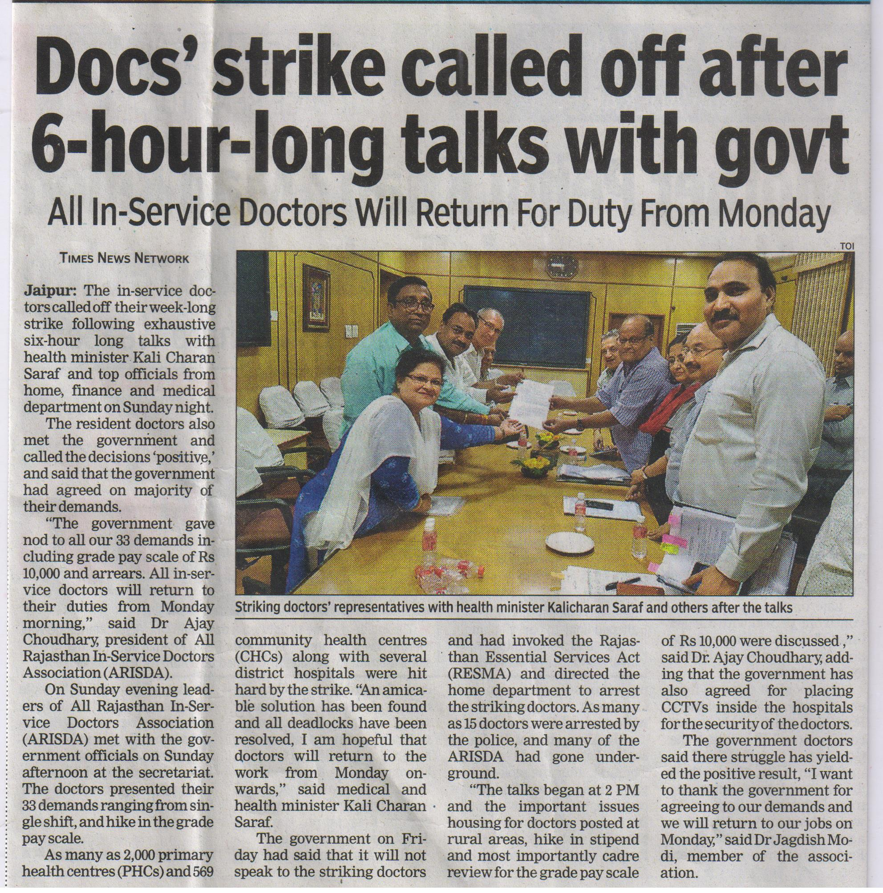

Slide 201
Look up : to try to find info in a book
Look after : to take care of
Look into : to examine the facts
Look through : to read or briefly examine
Look forward : to eagerly expect something to happen
Look down upon: to consider someone to be inferior

Slide 202
Go on : to happen ex ; what is going on there ?
Go by : to pass ex : two hours went by
Go through : ( 1 ) to examine ( 2 ) to undergo / experience

Slide 203
Articles

Slide 204
Uses of “THE”

Slide 205
Unique NOUNS
The Moon, The Sun , The Sky.
Holy Books
The Quran , The Bible.
Superlative degrees
The richest , The tallest.

Slide 206
Two comparatives in a single sentence.
The more we earn , The more we spend,
The harder he thought ,
The more confused he became,

Slide 207
S . S . C . SECTION OFFICER EXAM 29 / 07 / 2001
The greater the demand , higher the price.
( 1 ) high ( 2 ) the high
( 3 ) the higher ( 4 ) no improvement
ANSWER : 3

Slide 208
When we talk about a particular person or thing we use The before it
This is The girl who got the first rank
The book which I gave him is expensive
Adjective used as a noun.
The rich, the poor , the blind , The Old.

Slide 209
Before comparative degree in case of a choice
Ex 1: she is the older of the two girls
Ex 2: he is the weaker of the two players
Before a unit of measurement
Ex 1:cloth is sold by the metre
Ex 2: Eggs are sold by the dozen

Slide 210
Before the armed forces
EX : The army ,The navy ,The air force.
Before the dynasties , empires , wars , revolutions , centuries.
Ex : The Gupta dynasty , The red revolution , The civil war , The seventh century , The British empire , The middle ages , The Vedic ages.

Slide 211
Before the names of physical positions
The right , The Left , The Middle
Important Designations
The P.M, The C.M, The President.

Slide 212
Before Ordinal Numbers
Cardinal - Ordinal
One
Two
Three
The First
The second
The third

Slide 213
Political Parties
The BJP ,The RJD.
Historical Events
The Salt Satyagraha.
The Quit India movement.
Names of Musical Instruments
The guitar, The flute.

Slide 214
We use a before names of musical instrument in the sense of one
He is good at playing the guitar.
He bought a guitar yesterday .
She practises the veena .
She has a veena at home .

Slide 215
Directions
The North, The East,
Names of Imp. Inventions
The T.V, The P.C
United countries
The U.S.A, The U.K, The U.A.E

Slide 216
Words which indicate Nationality.
The Indians, the Americans,
Noun that represent the whole class.
The Cow is a useful animal,
The peacock is a beautiful bird.

Slide 217
Before persons or things which are already mentioned in the same context.
The person who cheated me was
caught last night.

Slide 218
Before the names of
news papers & magazines
The Hindu,
The India today.

Slide 219
Before the words same & whole.
The whole country regretted his death.
After the words all & both when
used with plural nouns.
Both the sisters are brilliant.
All the questions are tough.

Slide 220
BEFORE THE NAMES OF RIVERS, OCEANS,
GROUP OF MOUTAINS, GROUP OF ISLANDS,GULFS ,DESERTS AND WATERFALLS.
.
EX : THE PERSIAN GULF / THE GANGES / THE PACIFIC / THE SAHARA / THE NETHERLANDS / THE HIMALAYAS.
Note : “ The “ is not used before Everest because it is a single peak not a mountain range .

Slide 221
Before names of trains / hotels / names of reputed organizations / names of families
Ex : The shathabdhi express / The Taj / The U.N.O. , The W.H.O. / The Tatas / The Birlas / The kapoors .

Slide 222
USAGE OF INDEFINITE ARTICLE

Slide 223
A is used before the words beginning with consonant sound . AN is used before the words beginning with vowel sound .
A E I O U are called vowels .
Rest of the 21 letters are called consonants .

Slide 224
A
One , universal , university , European
Union , unique , utensil , utopia.
AN
HOUR , HONEST MAN , HONOURABLE PERSON ,
S.I. , L.L.B., M.A., M.B.A.

Slide 225
A SUB - INSPECTOR
An S . I .
A lawyer
An L . L . B .

Slide 226
IT IS USED : INSTEAD OF THE WORD ONE ,
EVERY , IN EXCLAMATIONS , AFTER THE
WORD “ SUCH “ , WITH WORDS LIKE FEW
LITTLE TO EXPRESS A POSITIVE SENSE ,
Before a singular countable noun.

Slide 227
Examples
( 1 )
I have a cousin in France ( one cousin ) , there is an umberella ( one )
( 2 )
He earns rs.500 /- an hour ( every hour / per hour )
( 3 )
She comes here twice in a week ( every week )
( 4 )
What a wonderful book ! / what a beautiful bungallow !
(
Exclamations
)
( 5 )
I have never read such an interesting novel .
( 6 )
I have a little money with me
( some money )
( 7 )
A few students in our class are interested in the special class .
( some students )

Slide 228
It is a fact (a) that cereals constitute major part (b) of the diet of our people. (c) No error (d)
ESE 2014
Answer : a major part .
Explanation : we need to use an indefinite article ( A /AN ) before a singular countable noun

Slide 229
Choose the grammatically INCORRECT sentence.
He is of Asian origin.
They belonged to Africa.
She is an European.
They migrated from India to Australia.
GATE 2013 ME + CS + PI
Answer : ( c )
Explanation : European begins with a vowel ( E ) but it gives a consonant sound .

Slide 230
GATE 2015 ME + CE (Online Exam)
The Tamil version of ______ John Abraham- starrer Madras Café ---- cleared by the Censor Board with no cuts last week, but the film “s distributors ___ no takers among the exhibitors for a release in Tamil Nadu ____ this Friday.
(a) Mr. , was, found, on (b) a, was, found, at
(c) the, was, found, on (d) a, being, find, at
Answer : ( c )

Slide 231
GATE 2016 EE + CS SET I - II
The man who is now a municipal commissioner worked as ____ .
the security guard at a university
(B) a security guard at the university
(C) a security guard at university
(D) the security guard at the university

Slide 232
Answer is “ B “
www.sahanafoundation.net

Slide 233
Omission of articles

Slide 234
No article is used before proper nouns.
(names of persons & places)
I met …….. Kishore
------ Hydarabad is a large city.
Exception : when we compare a proper noun with another proper noun , we use the before the compared proper noun .
Ex: kalidas is the shakespeare of India , prabhudeva is the michael jackson of our country .
He is the Einstein of our town . ( the most intelligent person in our town )
He is an Einstein of our town . ( one of the most intelligent persons in our town )

Slide 235
2. No article is used before material
nouns and abstract nouns.
(Gold, Silver, Copper, Water, Wood,
Milk… )
(Honesty, Wisdom, Happiness,
youth… )
Exception :
When they are made specific we use the before them .
Ex : The gold imported from gulf countries is heavily taxed .
The courage shown by Bhagat singh was incredible
.
The patience of the leader is what made him so great .

Slide 236
No article is used before names of languages .
He speaks the English fluently
I think it is difficult to learn a chinese
But we say :
The English language
THE ENGLISH : ENGLISH PEOPLE
THE FRENCH : FRENCH PEOPLE

Slide 237
No article is used before the places
like School, College, Hospital, Office, prison , market , Church , masjid , Temple , bed , table etc .
When they are used for primary
purpose.

Slide 238
5. No article is used after words like Sort
of, Kind of, Type of & manner of…..
Eg : what sort of a bird is it ?

Slide 239
Before uncountable nouns
An advice , the weather , a fun.

Slide 240
6. Before the names of meals
A supper , the dinner, a lunch
But when the name of a meal is made specific , we use the before it
Ex : ( 1 ) The lunch that I had in the flight was hardly sufficient .
( 2 )
The dinner , we had in the Taj was quite expensive .

Slide 241
A
B
C
D
We / shall see him / after the dinner / no error
ESE 2014
Answer : c ( dinner in place of the dinner )
www.sahanafoundation.net

Slide 242
Before the names of seasons :
The winter , The summer.

Slide 243
7.
Modes of transport
They will go by the air
We had a pleasant journey by a road

Slide 244
8
BEFORE NAMES OF DISEASES :
He died of a cancer
The cancer is a dangerous disease
Exception : The plague , The cholera ,
The flu .

Slide 245
QUESTIONS FROM WORK BOOK

Slide 246
Most of the residents (A) were inside the building(B) when it was collapsed. (C)
No error (D)
ANS : A ( it collapsed in place of it was collapsed )
Does it matters (A) whether a cat is white
or black (B) as long as it catches mice?. (C)
No error (D)
Ans : A ( DOES IT MATTER IN PLACE OF DOES IT MATTERS )

Slide 247
Do / does / did
V1
Donot / doesnot / didnot
V 1 : PRESENT OF VERB ( GO )V 2 : PAST FORM OF VERB( WENT ) V 3 PAST PARTICIPLE ( GONE) V 4 PRESENT PARTICIPLE ( GOING )

Slide 248
3. My friend (A) worked hard (B) with a view to
pass the examination (C). No error (D)
ANSWER : C ( PASSING IN PLACE OF PASS )
“ WITH A VIEW TO “ TAKES GERUND ( V 4 )

Slide 249
4. Though it is a month since he has left us,
(A) he has not written to us yet, (B) and we
do not know what he has been doing.(C)
No error (D)
ANSWER : A
It has been a month since he left us

Slide 250
She was ashamed (A) when she remembered (B) that she did not visit her mother for a year (C) No error (D)
Ans : C
she had not visited IN PLACE OF she did not visit
Between two actions in the past , the former should be in past perfect and the latter should be in simple past

Slide 251
Respectfully l beg to state that (A) I am
suffering from fever (B) for the past
fortnight (C) No error (D)
ANSWER : B ( HAVE BEEN IN PLACE OF AM )
7. I have sent you (A) a letter (B) last month.(C)
No error (D)
ANSWER : A ( I SENT IN PLACE OF I HAVE SENT )

Slide 252
8. Were they having (A) a car when they (B)
were living in Bangalore ? (C) No error (D)
Answer : A ( did they have in place of were they having )
Have should not be expressed in ING form

Slide 253
8. Were they having (A) a car when they (B)
were living in Bangalore ? (C) No error (D)
ANS : A ( DID THEY HAVE )
9. When Rima came to India (A) she had to
get used (B) to drive on the left (C)
No error ( D ) ANS : C ( DRIVING )
BE / GET + USED TO TAKES GERUND ( V 4 )

Slide 254
possess
Have
Take
Receive
Experience
Have cannot be expressed in continuous tense when used in the sense of possess .
In all the rest of the three senses it can be used .
Ex : I am having a severe headache ( experience )
She was having the material when I came here ( take )
You will have a mail next week ( receive )

Slide 255
MODALS
A verb used to express the mood of a speaker is called modal auxiliary .
List of modals
Can , could , may , might , shall , should , will , would , must , ought to , need , dare , have / had to , be to , be able to , going to .
These modals suggest : permission / possibility / promise / ability / advice / obligation /request / duty / necessity / prohibition etc .

Slide 256
Uses of modals
Can ability / permission / prohibition
Examples : he can speak four languages ( is able to speak )
Can I take your book ? ( permission ) yes you can ( permission ) no , you can’t ( denying permission )
You cannot go there without my permission ( prohibition )
Could
Past ability / request / permission / possibility / past improbable condition .
Examples : I could run 10 kms at a stretch in my college days ( past ability : I was able to )
Could you please help me ? ( request ) ; could I speak to you ? ( permission )
He could be a police officer ( possibility )
You could have done it ( you had the ability to do it but you did not )

Slide 257
May possibility / permission / wish or prayer / purpose / past uncertainty
The chief minister may visit our place ( possibility ) :
May I come in ? ( permission )
May his soul rest in peace ( prayer ) ; may god bless you ( wish )
Walk regularly so that you may be healthy ( purpose )
Might
Possibility / as a the past form of may / past uncertainty
He might excuse them ( more doubtful possibility than may )
She said that she might go to France . ( as the past form of may )
The police might have arrested him ( past uncertainty – we do not know it clearly )

Slide 258
Should
1. duty / obligation : we should finish the task in time
2. As the past form of shall : he told me that I should listen to him
3. After the word lest : work hard lest you should fail
4 . Obligation in the past : you should have taken permission
( You did not )
Must
1. Necessity : He must consult a doctor ( stronger than should )
2. Command : you must follow our instructions
3 . Possibility : She must be in the office now ( stronger than may )
4 . Past uncertainty : They must have gone home ( stronger than might have gone )

Slide 259
OUGHT TO It is stronger than should but not so forceful as must.
it is always followed by ‘ TO ‘
1 .Duty or moral obligation : you ought to complete the work today ( ( duty )
We ought help the needy ( moral obligation )
2 . Past unfulfilled action : He ought to have informed the clients ( he did not inform )
They ought not to have spent so much ( they spent more than needed )
Used to
1.
Past habit : I used to read a lot in my college days / she used to play Tennis .
2 . As an adjective ( be used to ) : I am used to taking a lot of stress . / they are used to wasting time .

Slide 260
Would
Request : would you please lend me some money ? / would you mind lending me some money ?
As the past form of will : He said that he would come home .
Wish : I would like to stay here .
Choice : she would rather die than beg her enemy .
Possibility : He would be a sports man ( possibly he is a sports man )
Recurring action in the past : They would practise swimming in this river till last year
Past improbable condition ( type 3 conditional ) : If you had asked me , I would have helped you .

Slide 261
Need
It is used both as a main verb and auxiliary verb ( helping verb )
As a main verb it has a meaning ( requirement ) , as a helping verb it has no meaning .
As a main verb it is used in positive sentences and as a helping verb it is used in negative and interrogative sentences
When used as a main verb : it takes S , and To .
When used as a helping verb : it does not take S and To .

Slide 262
Examples : I need to finish two batches in a week ( main verb )
You need not invest anything ( helping verb )
She needs to take coaching ( main verb )
Need they come here now ? ( helping verb )
They needed to stay in the office till 9p.m.

Slide 263
Dare : it is used as both a main verb and a helping verb
As a main verb it has the meaning of challenge and have courage .
The rules of DARE are the same as those of NEED
HAVE TO necessity / compulsion / duty ( less intense than should / need / must )
Examples
I have to report to the G.M. in Mumbai ( duty )
He had to bribe the officers to get the license ( past compulsion )
She has to spend a lot for the treatment ( necessity )
They will have to submit the file by 20th march ( future compulsion )

Slide 264
Going to it is used to express something with certainty
Subject + be + going to + V1 + OBJECT
I am going to buy a new car
She is going to join politics soon
They are going to win the match
Be to : plan / order / duty
I am to conduct a meeting next week ( plan ) / you are to answer the questions ( order ) / he was to take the charge in the absence of his Boss .

Slide 265
Be able to : it is used to express the capacity .
My friend is able to swim across the river ( he can )
She was able to win 5 matches continuously ( she could )
I am able to understand your problem ( I can )
Had better : it is used to express a suggestion
You had better take coaching
She had better study further
I had better start now ( self suggestion )

Slide 266
FREQUENTLY TESTED RULES ON MODALS
1. Only 1st form of verb should be used with modals
2.” Should / could /would / might + have “ takes only 3rd form of verb
3 . Had better should never be used with “ TO “
EX : you had better to stay there
4 . Able should not be used with can and could
I can able to convince him
Or
I am able to convince him
5 . Would you mind always takes gerund ( V4 )
EX . Would you mind to go there ?
Would you mind going there ?

Slide 267
6 . Lest is always followed by should , no other modal is permitted .
7 . In imaginary sentences we have to use only past forms of modals like would / should / could / might , not will / shall / can / may .
Ex . I wish I can swim well
I wish I could swim well
If I were you , I will accept this proposal
If I were you , I would accept this proposal

Slide 268
8 . When ever we use would rather to expresses a preference ( choice ) we need to use only the 1st forms of verbs .
Ex : I would rather continue studies than doing a job .
I would rather continue studies than do a job .
She would rather take rest than watching a movie now .
She would rather take rest than watch a move now .

Slide 273
page 110
10. Miscellaneous
Practice Exercise:(1)
Hardly the inspector had arrived there (A) to investigate the crime. (B) when the house was set ablaze (C) No error (D)

Slide 274
PAGE NO : 110
NO SOONER
+
DID + SUB + V 1 + OBJ
HAD+SUB + V 3 + OBJ
+
THAN + SUB + V 2 + OBJ

Slide 275
HARDLY
+
+
WHEN
+
SUB
+
V2
DID + SUB+ V 1 +OBJ
SCARCELY
HAD + SUB + V 3 + OBJ
BEFORE

Slide 276
Page 110
2. He lay the watch on the table (A) and then forgot all about it (B)
when he went out. (C) No error (D)

Slide 277
LIE – LIED -LIED
LIE – LAY – LAIN
LAY – LAID – LAID

Slide 278
Page 111
3. Being a sunny day (A) I decided to
skip work (B) and stay at home. (C)
No error (D)

Slide 279
It being a sunny day
being an I.A.S. everybody respects him .
Being an I.A.S. , he is respected by everybody.
being a good teacher all the students admire her.
Being a good teacher , she is admired by all the students

Slide 280
Page 111
4. The company not only manufactures (A)
leather goods but (B) also plastic ware.(C)
No error (D)

Slide 281
The company
Manufactures
not only
leather goods
but also
Plastic ware

Slide 282
Page 111
5. In future when I shall meet you (A)
I shall explain (B) the causes of solar
and lunar eclipses. (C) No error (D)
6. He has left home yesterday, (A)
though there was no need (B) for him
to do so. (C) No error (D)

Slide 283
when
If
unless
until
As soon as
SUB + V 1
SUB + WILL + V1
As early as
before
after
By the time

Slide 284
Page 111
7. Since I drew his attention to some of
his faults (A) he became angry upon
me (B) but I have great regard for him.
(C) No error (D)
8. No sooner did the cat (A) move away
when (B) the mice began to play. (C)
No error (D)

Slide 285
No sooner
Than

Slide 286
Page 111
9. He walked (A) till the end (B)
of the street. (C) No error (D)
10.He lost his new (A) knife shortly
after (B) he bought. it. (C)No error(D)

Slide 287
Page 111
11. Many a student are (A) frustrated because (B) of unemployment. (C) No error (D)
12. The article should not (A) exceed more than (B) five hundred words. (C) No error (D)

Slide 288
Page 111
13. The Chief Minister couldn't but help (A)
shedding tears at the plight of the (B)
villagers rendered homeless by a
devastating cyclone. No error (D)
14. Emphasis on equality of life ensures (A)
for the health and happiness (B)
of every individual. (C) No error (D)

Slide 289
verb + preposition + object
Verb + object

Slide 290
Page 111
15. Please understand that (A) the dispute on
this issue is between my brother and myself
(B) and concerns no body else. (C)
No error (D)

Slide 291
A preposition is followed by the object case of pronoun
I
ME
MY
MYSELF

Slide 292
There were gapes of(a)/ horror from the spectators when(b) /the performer fell from the tight rope(c )/ no error(d).

Slide 293
Gape : an expression of surprise
Gasp : an expression of shock / fear
( a short , quick breath through the mouth )

Slide 294
17. She gazed at me(A) in misbelief
when (B) I told her the news. (C)
No error (D)
Page 112

Slide 295
MISBELIEF : WRONG BELIEF
DISBELIEF : LACK OF BELIEF

Slide 296
Page 112
18. Acting from inside information (A) the police were able to arrest the gang (B) before the robbery occured. (C) No error (D)

Slide 297
Page 112
19. She wanted to be an actress, (A) but her father soon (B) nipped that idea in the bud. (C) No error (D)

Slide 298
Page 112
19. She wanted to be an actress, (A) but her father soon (B) nipped that idea in the bud. (C) No error (D)

Slide 299
Page 112
20. As monsoon failed this year (A)
drinking water will be supplied (B)
on alternative days. (C) No error (D)

Slide 300
Page 112
21. Many a student (A) in our college (B)
are extremely fond of the new game. (C)
No error (D)

Slide 301
Page 112
22. During India's struggle for freedom (A) many brilliant students (B) gave up their studies by Mahatma Gandhi's call. (C) No error (D)

Slide 302
Page 112
23. The world we live presents (A) an infinite
variety (B) of experiences everyday. (C)
No error (D)
24. Any meaningful discussion of national
integration (A) must take stock about the
tendencies (B) which threaten it. (C)
No error (D)

Slide 303
The world we live in
The world in which we live

Slide 304
Page 112
25. The lion told the fox (A) that he is
very weak (B) and that he had no
appetite. (C) No error (D)
26. The traveller was so hungry (A)
that he gulped all the food (B)
placed over the table.(C) No error(D)

Slide 305
The lion said to the fox , “ I am very weak and that I have no appetite. “
The lion told the fox that he was very weak and that he had no appetite.

Slide 306
Page 112
27. You may have to regret later (A) if you do not start living (B) within your mean. (C) No error (D)
28. What made him to do it, (A) or who
provoked him (B) is still not known. (C)
No error (D)

Slide 307
Page 112
29. The job wasn't interesting (A) but on
the contrary (B) it was well paid. (C)
No error (D)
30. How birds know (A) when to fly
south (B) for the winter? (C)
No error (D)

Slide 308
STATEMENT : SUBJECT + VERB
QUESTION : VERB + SUBJECT

Slide 309
31. These are (A) his (B) conclusion
remarks. (C) No error (D)
32. The shopkeeper either offered to
exchange (A) the goods (B) or refund the
money. (C) No error (D)
PAGE 113

Slide 310
Conclusion remarks
NOUN + NOUN
Conclusive remarks
ADJECTIVE + NOUN

Slide 311
Page 113
33. Churchill was (A) one of the greatest (B) war leaders. (C) No error (D)
34. We should keep (A) such people (B) at an arm's length. (C) No error (D)

Slide 312
Page 113
35. That was very dangerous (A) you might (B) have been killed. (C) No error (D)
36. I started early (A) for the station lest I (B) should not miss the train. (C) No error (D)

Slide 313
Page 113
37. They made him treasurer (A) because
they considered (B) him as honest and
efficient. (C) No error (D)
38. The President reached back (A) this
morning (B) after a visit to the southern
States (C) No error (D)

Slide 314
Page 113
39. Egyptian cotton (A) is superior (B) than Indian. (C) No error (D)
40. Your shirt (A) looks so good. (B) Where you bought it from? (C) No error (D)

Slide 315
Where did you buy it ?
Where did you buy it from ?

Slide 316
Page 113
41. A miser man (A) spends very
little (B) even on food. (C)
No error (D)
42. All (A) the glitters (B) is not
gold. (C) No error (D)

Slide 317
Miser man
NOUN + NOUN
Miserly man
ADJECTIVE + NOUN

Slide 318
Page 113
43. The administrator is entrusted the responsibility (A) of the overall management of an industry (B) while the technical personnel remain advisors to the administration. (C) No error (D)
44. My friend (A) worked hard (B) with a view to pass the examination. (C) No error (D)

Slide 319
Page 113
45. We (A) shall see him (B) after the
dinner. (C) No error (D)
46. He looked up (A) into the matter
(B) with keen interest. (C)
No error (D)

Slide 320
PAGE 114
47. He went to the house (A) and I (B)
followed with him. (C) No error (D)
48. My oldest son (A) is coming back (B)
from the USA this month. (C)
No error (D)

Slide 321
Things / persons without blood relationship
OLD – OLDER -- OLDEST
OLD -- ELDER -- ELDEST
Persons with blood relationship

Slide 322
PAGE 114
49. The police entered into the house and (A) questioned the head of the family (B) about the theft. (C) No error (D)

Slide 323
Practice Exercise: (2)
1 Either Ram or (A) you is responsible (B) for this action. (C) No error (D)
2. By the time you arrive tomorrow (A) I have finished (B) my work. (C) No error (D)
PAGE 114
Answer : B ( ARE INPLACE OF IS )
Answer : B ( I SHALL HAVE FINISHED INPLACE OF I HAVE FINISHED )

Slide 324
PAGE 114
3. The captain with the members of his
team (A) are returning (B) after a
fortnight. (C) No error (D) answer : B ( is in place of are )
4. After returning from (A) an all-India
tour(B) I had to describe about it. (C)
No error (D)
Answer : C ( delete about )

Slide 325
PAGE 114
5.The teacher asked his students (A)
if they had gone through (B)
either of the three chapters included in the
prescribed text. (C) No error (D)
6.Although they are living in the country (A)
since they were married. (B)
they are now moving to the town(C)
No error (D)
Answer : C ( any in place of either )
Answer : A ( they have been in place of they are )

Slide 326
EITHER - NEITHER : 2
ANY – NONE : 3/3+

Slide 327
PAGE 114
7. Do you know (A) how old were you (B)
when you came here? (C) No error (D)
8. None of the applicants have turned up
(A) for the interview(B) on time. (C)
No error (D)
Answer : B ( YOU WERE IN PLACE OF WERE YOU )
Answer : A ( HAS IN PLACE OF HAVE )

Slide 328
DIRECT QUESTION : VERB + SUBJECT
What is your name ?
how did he solve it ?
INDIRECT QUESTION : SUBJECT + VERB
May I know what your name is ?
Can you tell me how he solved it ?

Slide 329
PAGE 114
9. Her mother did not reply (A) when I asked her (B) why was she weeping. (C) No error (D) answer : C ( she was in place of was she )
10.The oxygen content of Mars is not (A) sufficient enough to support life (B) as we know it. (C) No error (D)
Answer : B ( either sufficient or enough)

Slide 330
I asked her why she was weeping
Why is used as a connective not as an interrogative word

Slide 331
PAGE 115
11. He told his friends that (A) each of them (B)
should be able to carry Out the orders oneself.(C)
No error (D)
12. If the police would have worked (A) in time (B)
the riot would not have occured. (C) No error. (D)
Answer : C ( himself in place of oneself )
Answer : A ( had worked in place of would have worked )

Slide 332
PAGE 115
13. The flag is risen in the morning (A) and taken down at night (B) by the guards. (C) No error (D) answer : A ( raised in place of risen )
14.I have seen (A) him going to the theatre (B) with his friends yesterday evening. (C) No error (D)
Answer : A ( I saw in place of I have seen )

Slide 333
RISE – ROSE - RISEN
To come up / increase ( Intransitive verb )
RAISE – RAISED - RAISED
To lift

Slide 334
PAGE 115
15. He was charged of murder (A) though,
the evidence did every thing (B)
to convince the judge of his innocence. (C)
No error (D)
16. Neither he nor his brother (A) is a good
student (B) but both are good players. (C)
No error (D)
Answer : A ( with in place of of )
Answer : D

Slide 335
PAGE 115
17. Suppose if you were left alone (A) to
live on a deserted island (B) what would you do ? (C) No error(D)
18. He wondered that what (A) would be
the next move of his opponents (B) who
had vowed to see him dislodged from
power. (C) No error (D)
ANSWER : A ( either suppose or if )
Answer : A ( that should be deleted )

Slide 336
PAGE 115
19. The nation should be grateful (A)
to the armed forces (B) for protecting
them. (C) No error (D)
20. I do not know (A) what is he doing(B to solve the problem.(C) No error (D)
Answer : C ( it in place of them )
Answer : B

Slide 337
What is he doing ?
I do not know what he is doing .
WHAT IS USED AS A CONNECTIVE NOT AS AN INTERROGATIVE WORD

Slide 338
PAGE 115
21. For so many years (A) it is almost his habit (B) to go to the bed at 10 p.m. daily. (C) No error (D) answer : C ( bed in place of the bed )
22. He took (A) down after(B) his father (C) No error (D)
23. His honesty (A) has never been (B) called the question. (C) No error (D)
Answer : B ( down should be deleted )
Answer : C

Slide 339
Call into question : to doubt / suspect .

